Slide 1
HD03 Hemodialysis Monitor:
Delivered Flow, Recirculation, and Access Flow Introduction

Slide 2
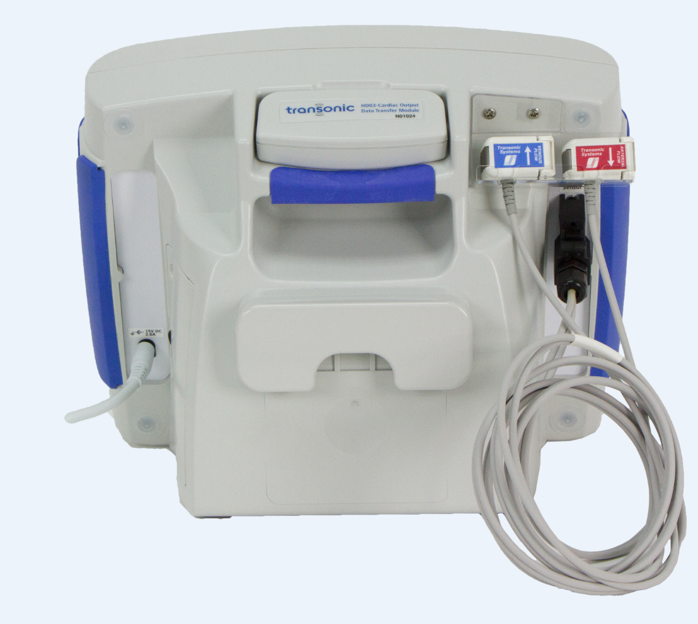
HD03 Monitor Components
Removable Data Transfer Module (DTM) or Patient-less Measurement Module (PMM)
Handle
Flow/dilution sensors in cradle
Battery pack
compartment
Sensor
connection
Power supply
connection
Pole Clamp Mount

Slide 3
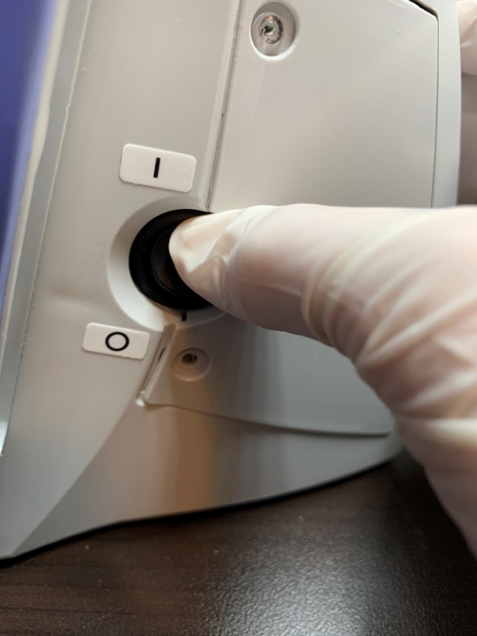
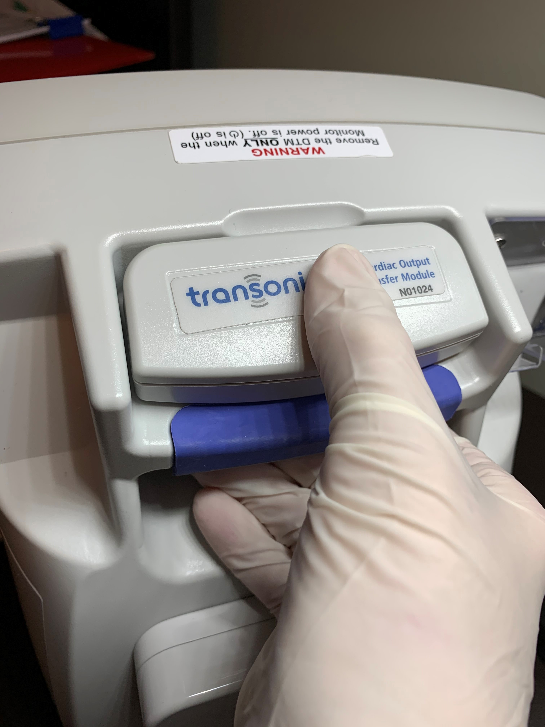
DTM or PMM Insertion Before Powering On
1. Ensure the DTM or PMM is completely inserted into the slot on the back of the HD03 Monitor
2. Turn the HD03 Monitor On by flipping the switch up
WARNING
Remove the DTM/PMM ONLY when the Monitor power is off (O is off)

Slide 4
Removable Data Transfer Module (DTM) or
Patient-less Measurement Module (PMM)
DTM
A Data Transfer Module (DTM/DTM-CO) that records patient information & measurement data to be transferred to a computer loaded with HD03 Administrative software for further analysis.
The DTM MUST be regularly synchronized with the Administrative software or the HD03 Monitor measurement function will greatly slow and could lead to screen freezes.
If unable to use the Administrative software, please contact Transonic for further assistance.
PMM
A Patient-less Measurement Module (PMM/PMM-CO) that does not save any patient information or measurement data.
No patient identification or patient list utilized.
Must record results manually as no results are stored in the PMM.

Slide 5
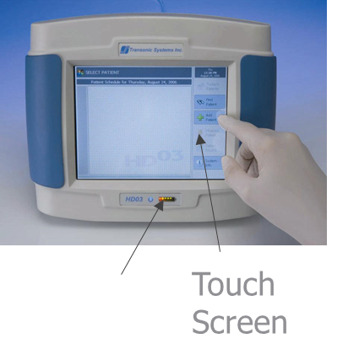
HD03 Monitor Battery
5 to 8 hour battery life
Battery Indicator Light is green with full charge
Indicator light then changes to yellow as the battery charge drops
A red light alone (steady or blinking) indicates the need for immediate recharging
The HD03 can always be used to perform measurements with the plugged-in power supply
Battery Indicator Light

Slide 6
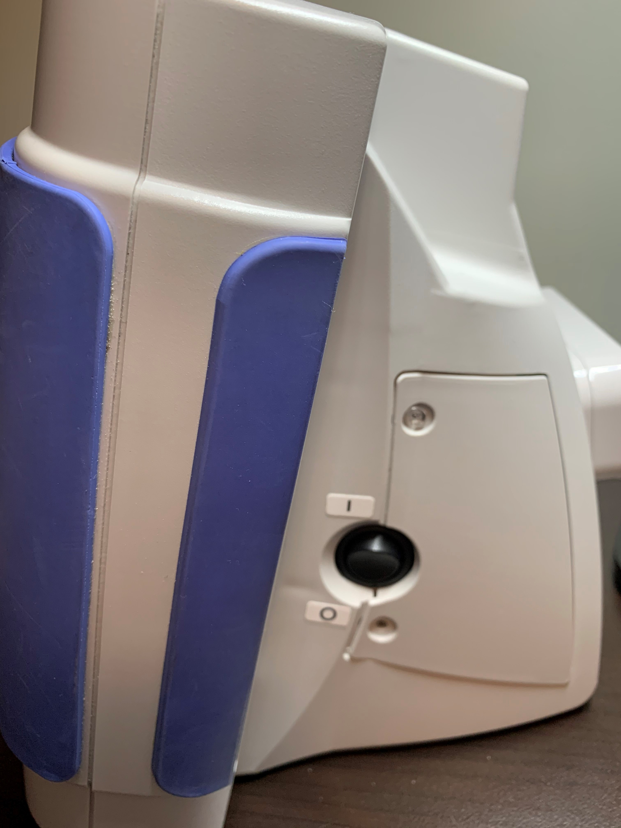
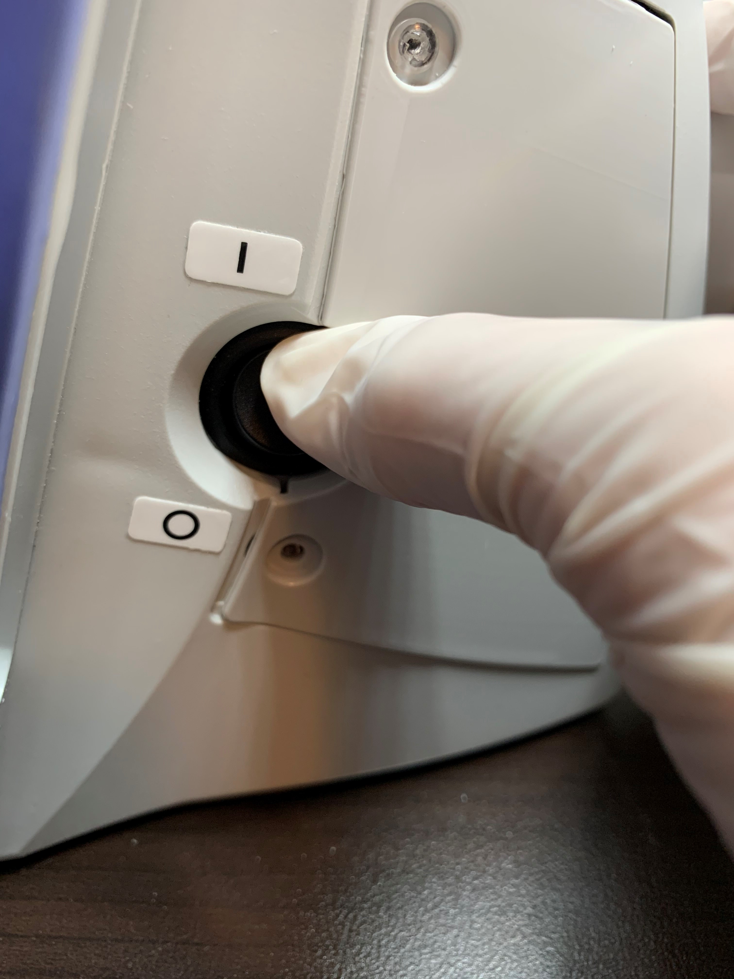
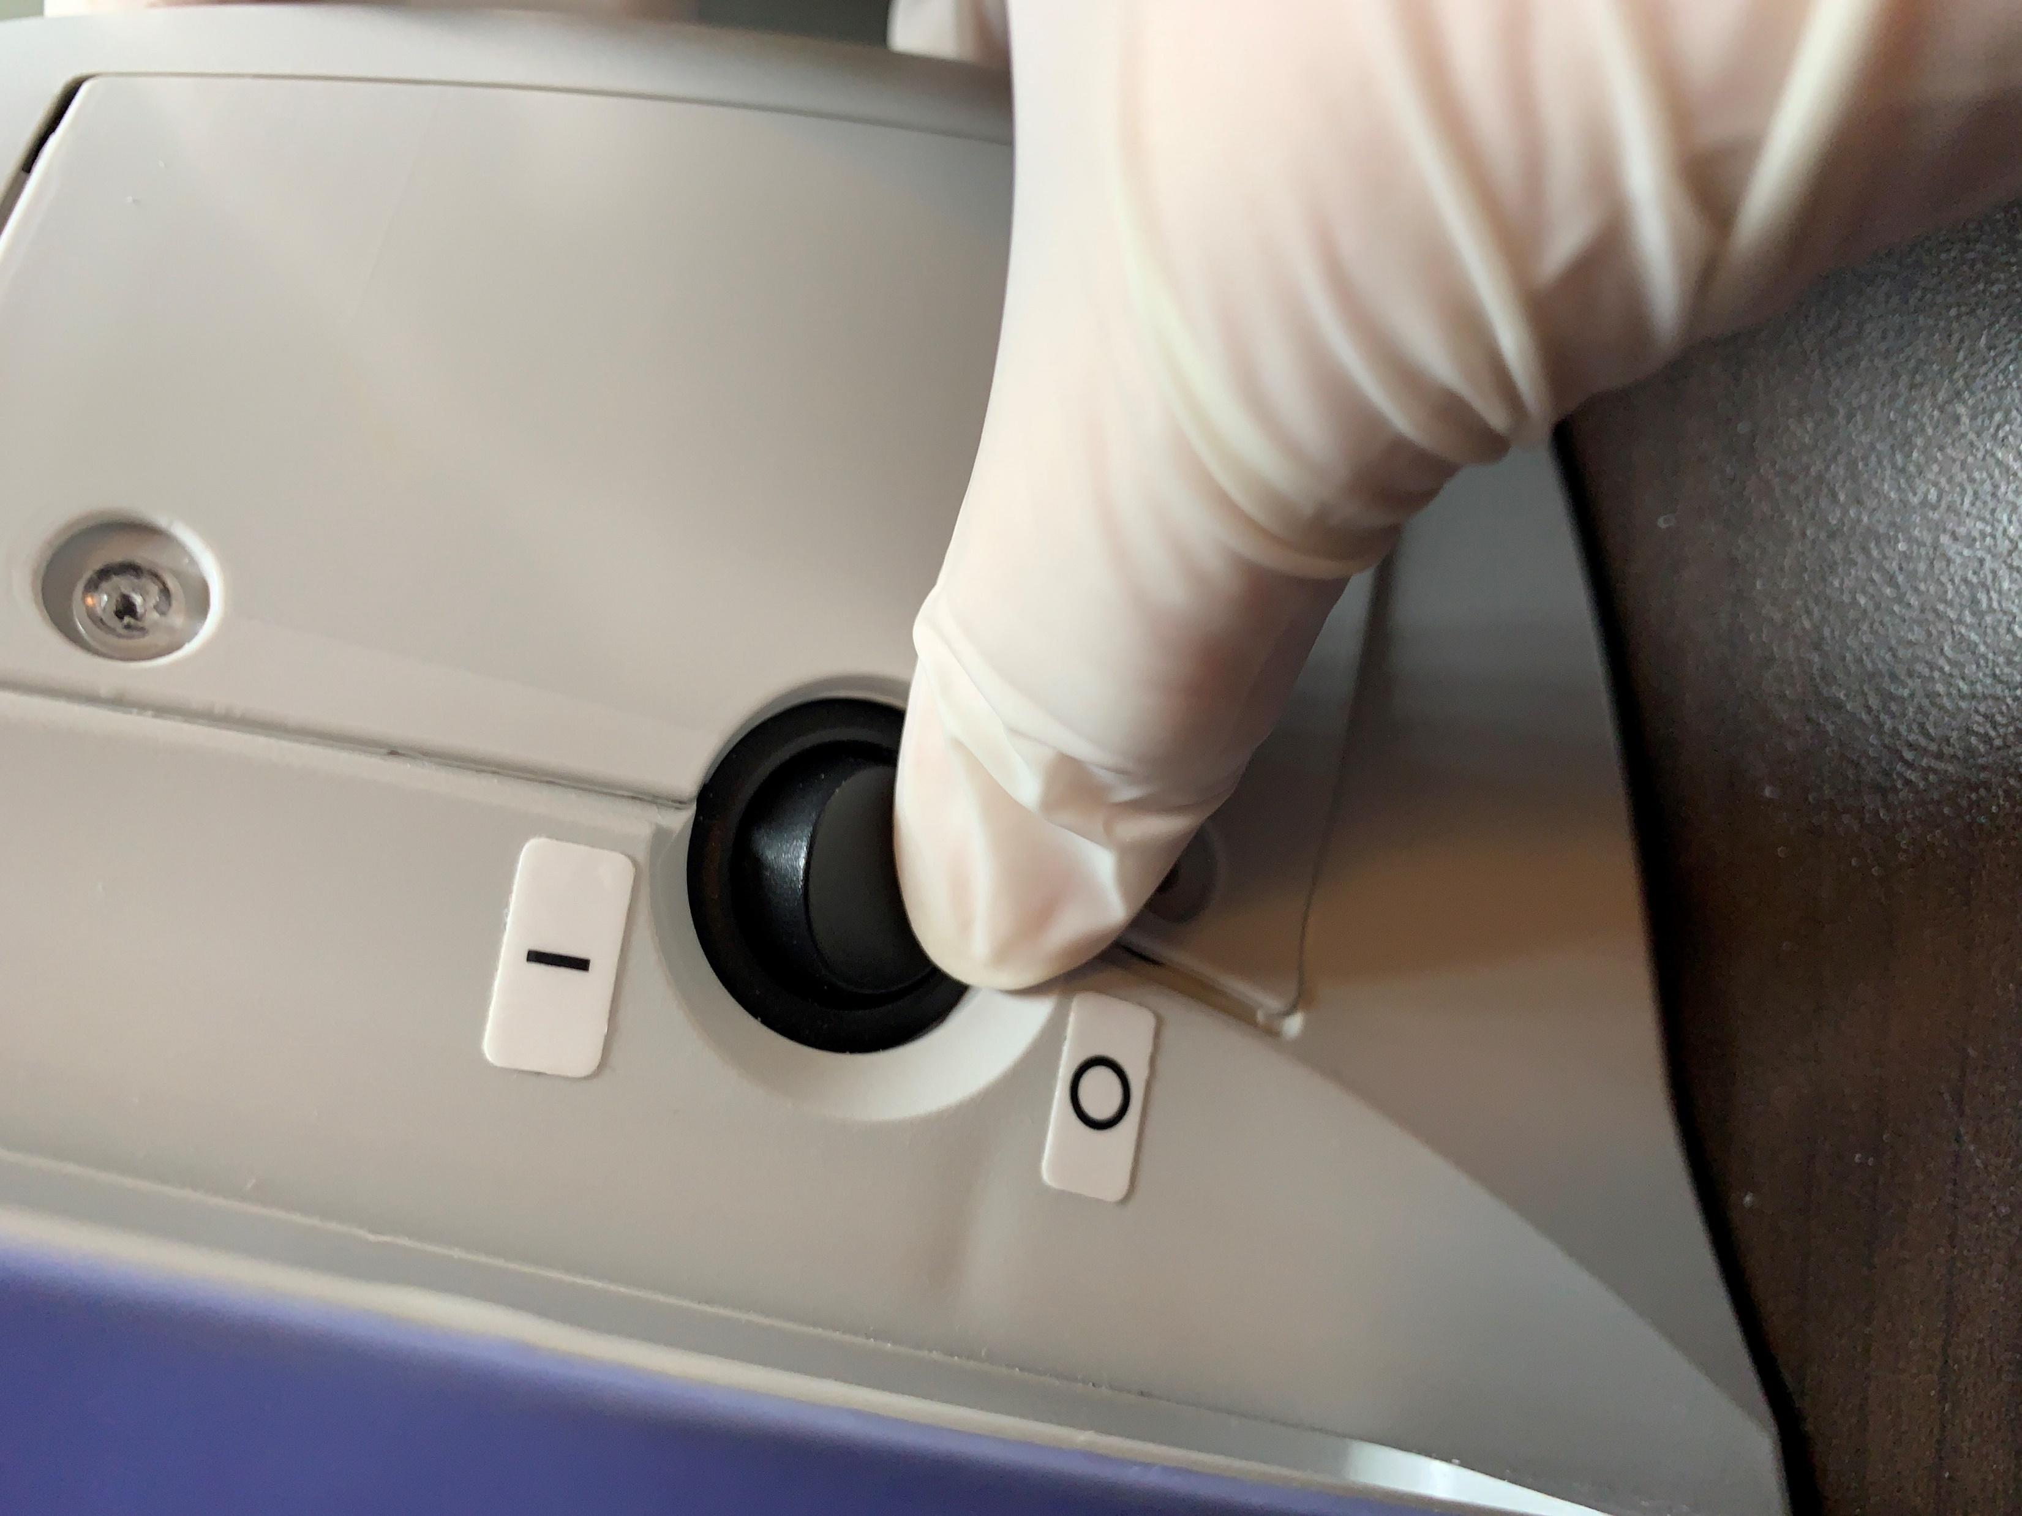
HD03 Monitor Components – Power Switch Right Side of the Monitor
Power Switch Off Position On Position

Slide 7

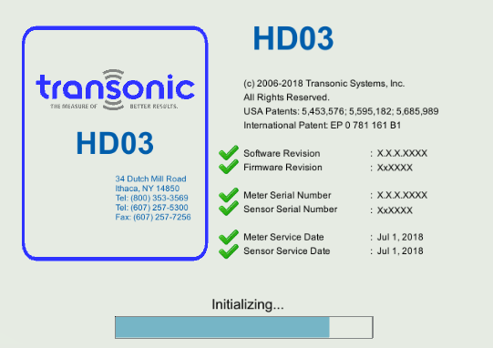
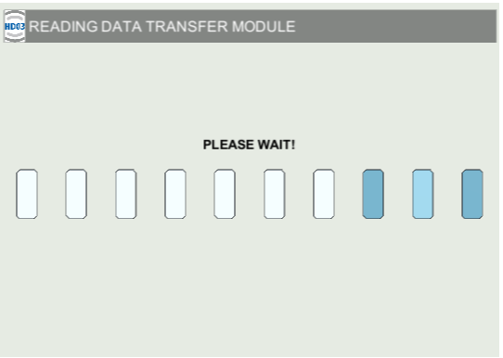
HD03 System Setup
Start-up screens appear when the HD03 checks for the DTM or PMM

Slide 8
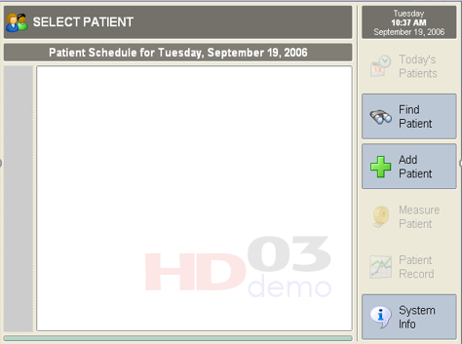
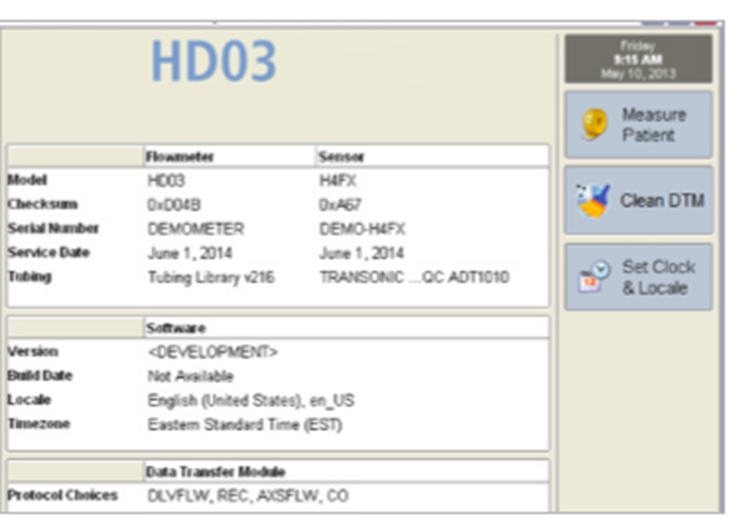
System Info DTM & PMM
PMM automatically displays the System Info as the last screen during the power-up sequence. To return to the screen, you must power cycle the HD03 (turn off then on)
DTM has a system information icon

Slide 9
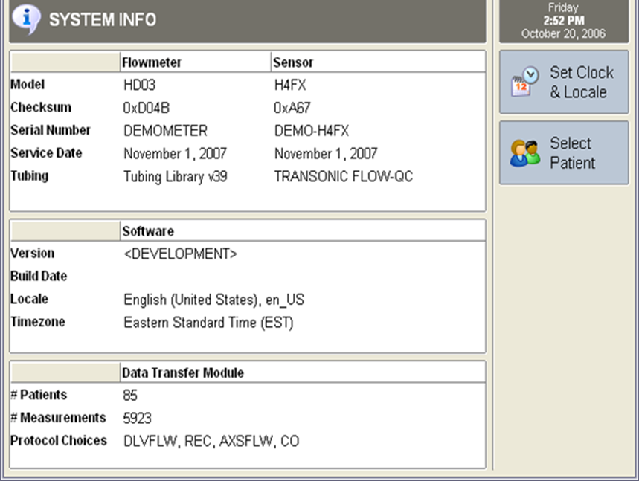
System Info DTM & PMM
Transonic Technical Support may request information from this screen:
Serial Number
Tubing Library version (bloodline listing)
Software Version
Service Date

Slide 10

HD03 System Setup
Confirm Clock & Location
are properly set

Slide 11
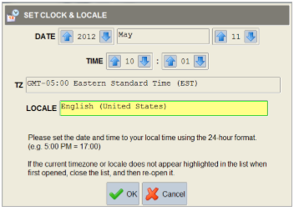
Set Clock & Locale
Select “Set Clock & Locale” to adjust Date, Time, Time Zone, and Locale.
Time is entered in a 24-hour format.
Locale selection controls the language translation and date & time format.

Slide 12

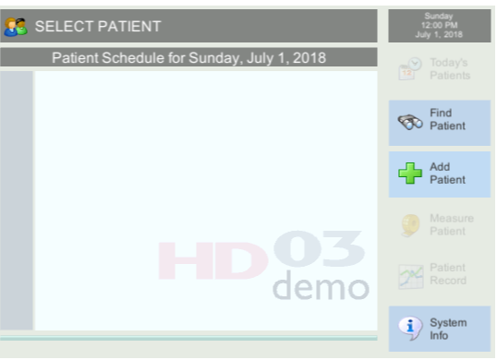
HD03 System Setup-Measure Patient
PMM Users will select “Measure Patient” (Refer to the PMM QRG)
DTM Users will need to Find or Add Patient (Refer to the DTM QRG)

Slide 13
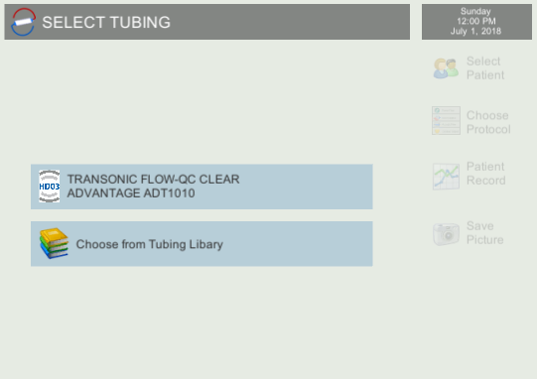
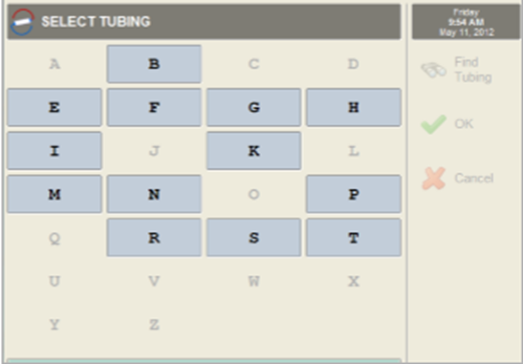
HD03 System Setup - Select Bloodline (Tubing)
Select the clinic-specific hemodialysis bloodlines (tubing). Bloodline is listed alphabetically by manufacturer, bloodline name, and product number.
Once selected, Bloodline (tubing) will populate in the dropdown menu for future measurements.

Slide 14

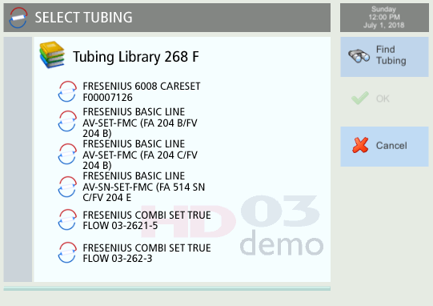
HD03 System Setup - Select Bloodline (Tubing)
Touch the first letter of the manufacturer of the bloodline (tubing). Example: “F” for Fresenius. Available Fresenius bloodlines (tubing) will appear.

Slide 15
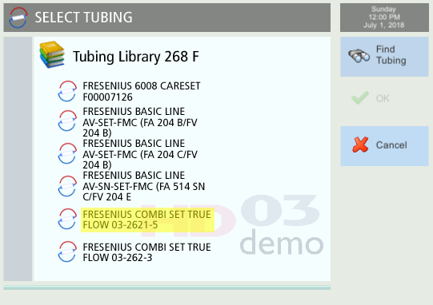
HD03 System Setup - Select Bloodline (Tubing)
Select the correct bloodline (tubing). Fresenius is used in this example. Double check that the name and catalog number match. Once selected, bloodline (tubing) will populate in the dropdown menu for future measurements.
Caution: An incorrectly selected bloodline (tubing) can not be deleted once the OK button has been confirmed.

Slide 16
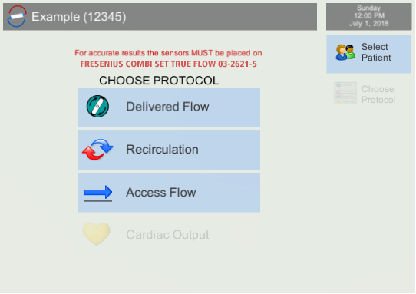
HD03 System Setup - Select Bloodline (Tubing)
The selected bloodline (tubing) will appear in Red Text above the protocol selection.

Slide 17
Delivered Flow, Recirculation, and Access Flow
Sensor Attachment Chairside Steps
Move to the patient station.
Prepare to attach the sensors to the patient’s hemodialysis
bloodlines (tubing).

Slide 18
Delivered Flow, Recirculation and Access Flow
Sensor Attachment Chairside Steps
Hemodiafiltration or I.V infusions via the extracorporeal circuit can interfere with saline dilution resulting in a Notification/Error Message.
If Hemodiafiltration Mode is active- disable HDF prior to attaching the sensors!
I.V. infusions should be paused prior to Recirculation or Access Flow measurements.

Slide 19
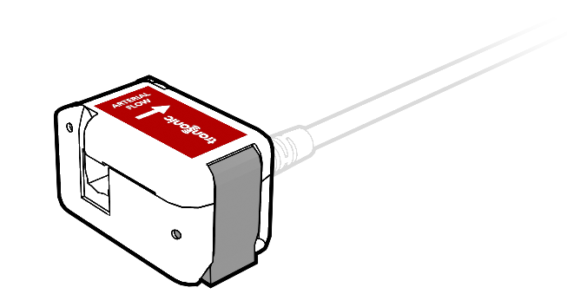
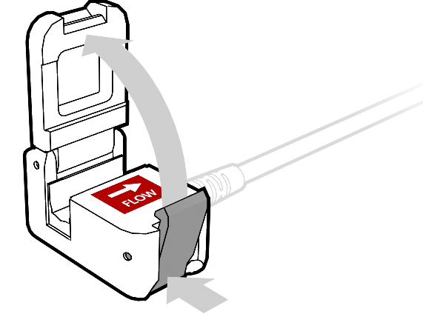
Placing Arterial Sensor on Bloodline (Tubing)
Placing Sensor Steps
The Sensor door opens by pressing the silver lever– see arrows in image

Slide 20
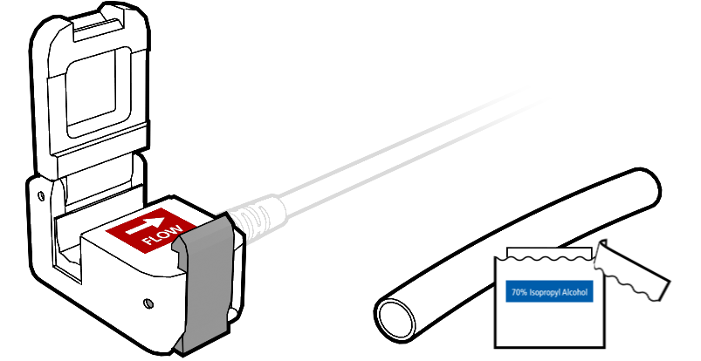
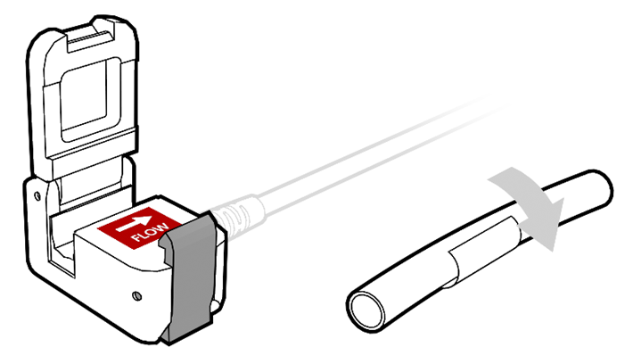
Placing Arterial Sensor on Bloodline (Tubing)
Placing Sensor Steps
Image A
Open the 70% alcohol prep (Image A)
Wet the bloodline (tubing) segment 5-10 cm (2-4”) from the needle connection (Image B)
Image B

Slide 21
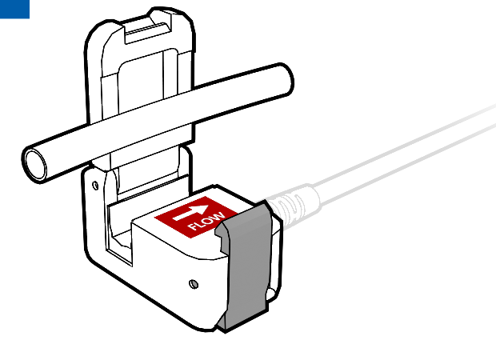
Placing Sensor on Bloodline (Tubing)
Placing Sensor Steps
Quickly insert the wet bloodline (tubing) segment into the Sensor 5-10 cm (2-4”) from the needle connection
The Arterial Sensor arrow must match the direction of the blood flow (arterial draw)
The Venous Sensor arrow must match the direction of the blood flow (venous return)

Slide 22
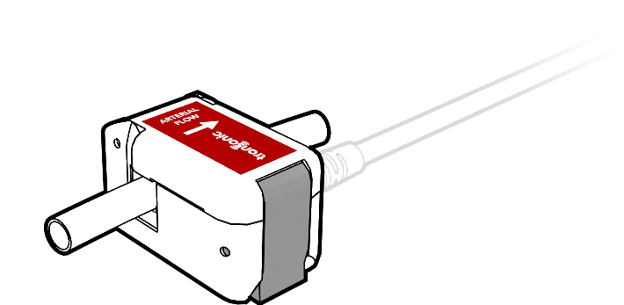
Placing Sensor on Bloodline (Tubing)
Placing Sensor Steps
The bloodline (tubing) segment must be fully inserted
Completely close the sensor door

Slide 23
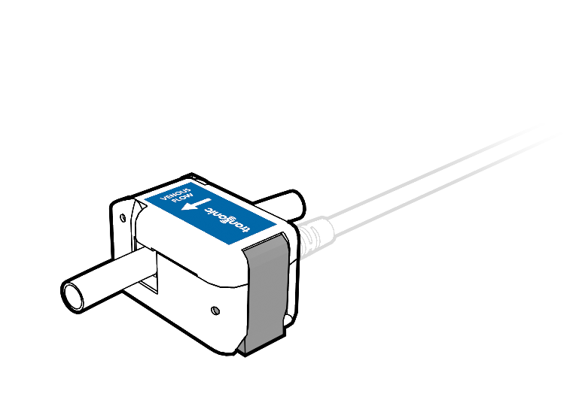
Placing Venous Sensor on Bloodline (Tubing)
Placing Sensor Steps
Repeat the same steps for the Venous Sensor & Venous Bloodline (tubing)
The Signal Strength should have green bars showing a good coupling

Slide 24
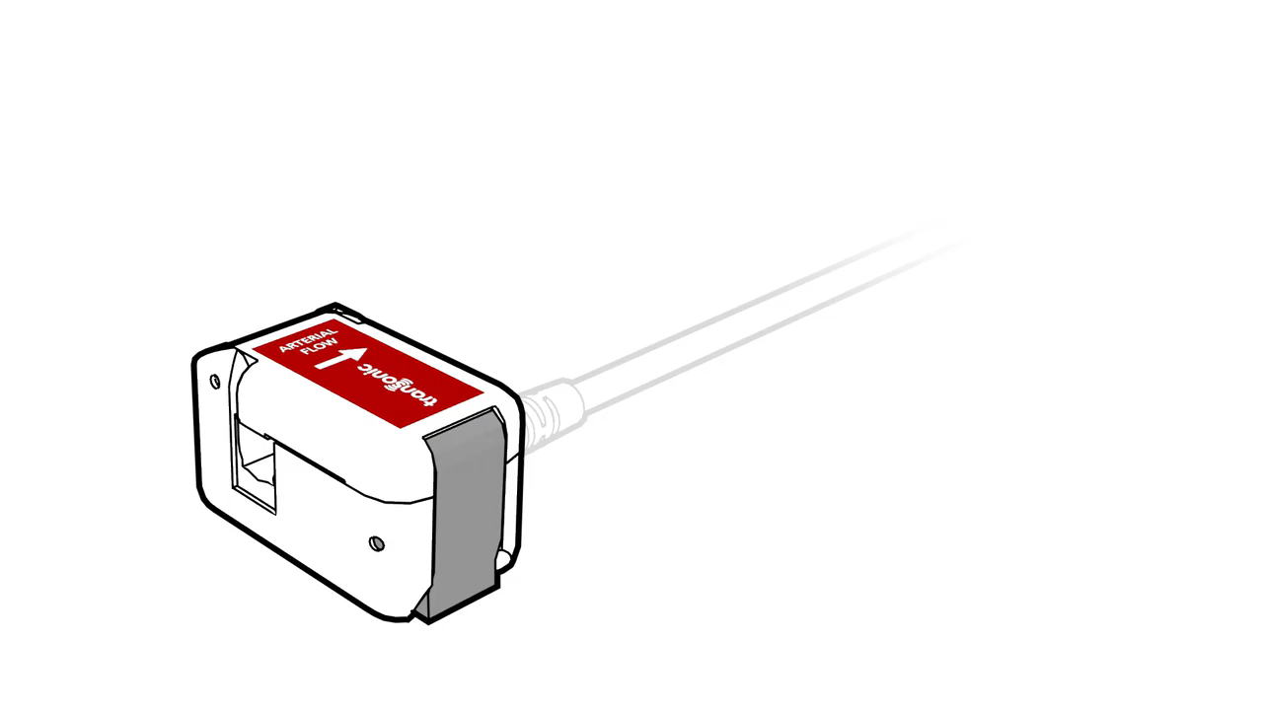
Click Below to Show Animation of Placing Arterial Sensor on Bloodline (Tubing)

Slide 25
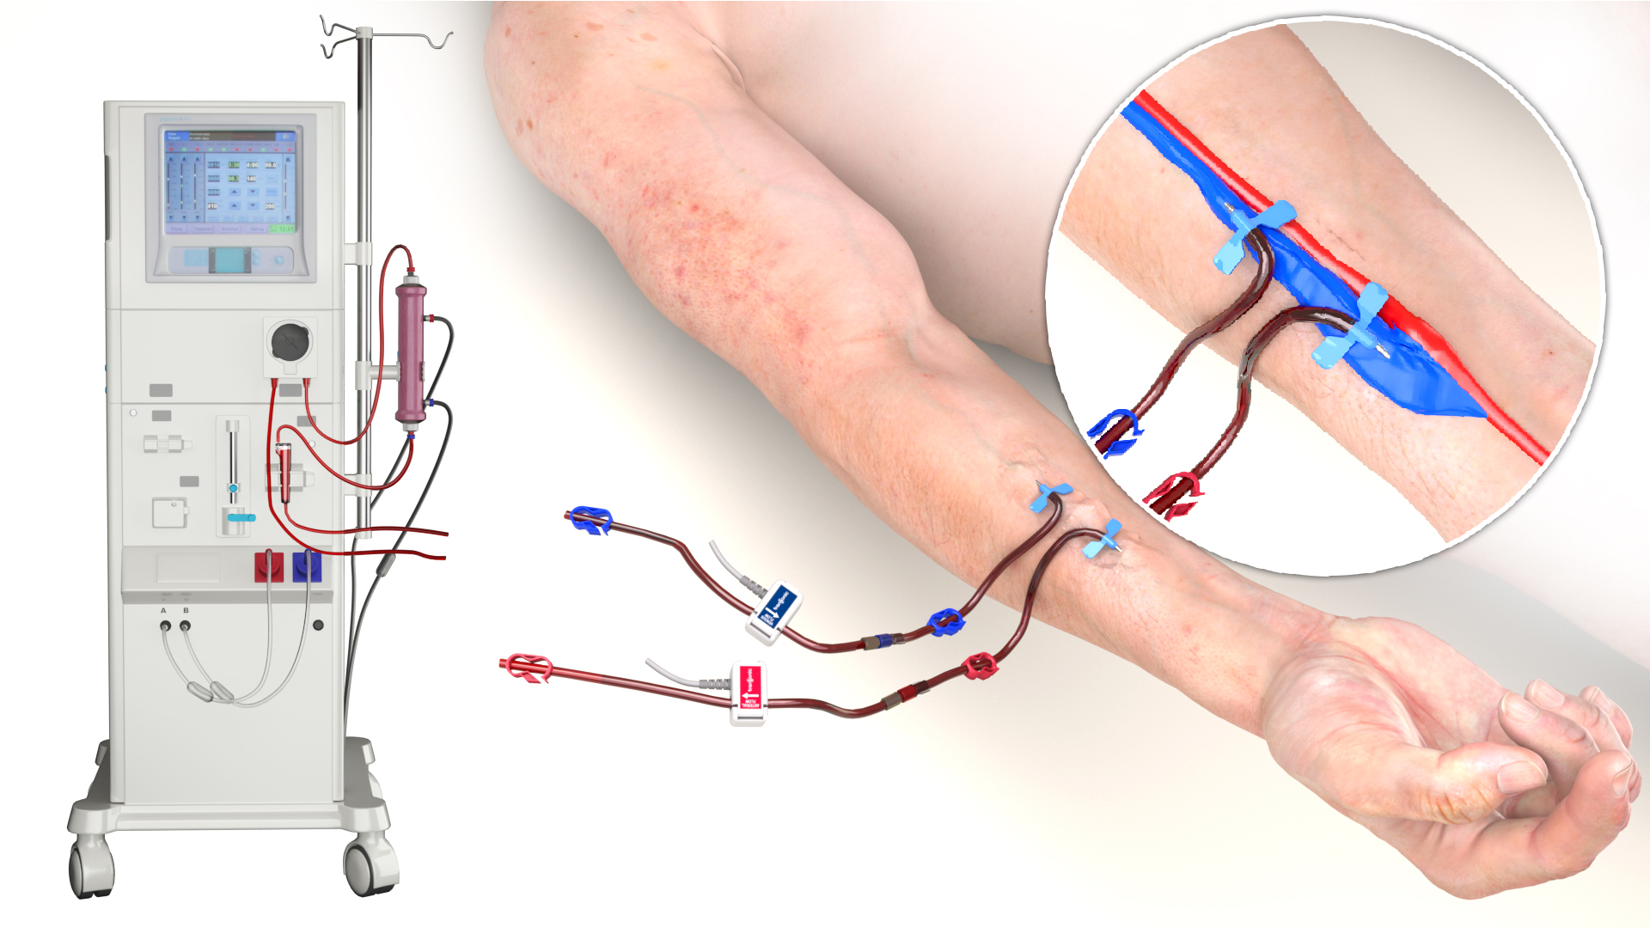
Properly Positioned Sensors
Placed Sensors
Properly placed Arterial & Venous Sensors on the bloodlines (tubing)

Slide 26

Signal Strength Indicator
Signal Strength
A Signal Strength indicator will display in the upper left of the Monitor screen.
Verify that this Signal Strength indicator is green. This means that the paired Sensors have adequate contact with the bloodline.
If the Signal Strength indicator is not green, a user notification may post “Check Sensor Coupling”.
Requiring repeat the [wipe-insert-close] sequence. If unable to achieve good signal contact Transonic Tech Support.
Good signal and ready for measurement
Weak signal.
User Notification “Check Sensor Coupling” will post if the signal is too weak for a measurement.

Slide 27
Troubleshooting Incorrect Sensor Placement
Problem:
Signal Strength Indicator is not green or there is a negative
delivered flow reading on the HD03 monitor.
Possible Solutions:
Check that the sensors are on the bloodline (tubing), not on the needle tubing.
Check that the arterial sensor is on the arterial bloodline and the venous sensor is on the venous blood line.
Check that the arrows on the sensors are pointing in the direction of blood flow.
Repeat alcohol application and quickly apply the sensors to see if the signal improves.

Slide 28
Infection Control: General Concepts
Proper PPE and infection control practices must be utilized to prevent infection or bloodborne pathogen exposure in accordance with your facility specific practices.
If the manual line reversal is utilized for the Access Flow measurements (AVF/AVG), then full PPE should be donned for the procedure.
If the catheter to bloodline connection is opened to reverse the connections for repeat Delivered Flow or Recirculation as part of the catheter dialysis adequacy optimization, then the same PPE required for the catheter connect/disconnect procedure should be utilized.
The Sensor housing and the Sensor cable should be disinfected after it is in contact with the patient's bloodlines and vascular access.
The Touchscreen should be disinfected between patients as it is a high touch surface.

Slide 29
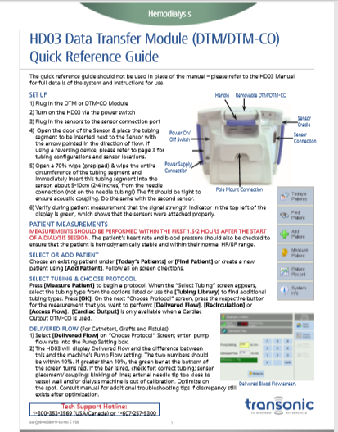
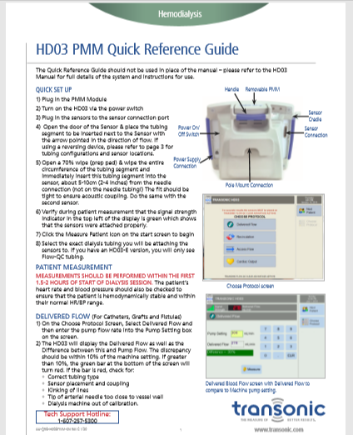

Transonic HD03 Tools www.Transonic.com

Slide 30
Transonic HD03 Tools www.Transonic.com
Customer Updates & Training Web Portal
Software Updates
Training Materials
Training Videos
Training Checklists
Operator’s Manuals

Slide 31
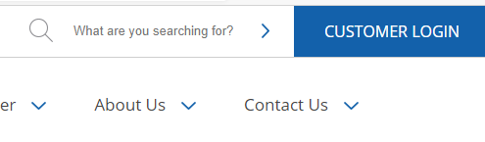
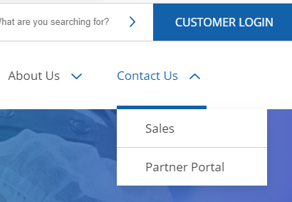

Customer Login to Access the Partner Portal
You can click on any of the three buttons to access the Partner Portal
Top right of the home page
Click on Contact Us then select Partner Portal
Click on Software Updates on the bottom of the home page

Slide 32
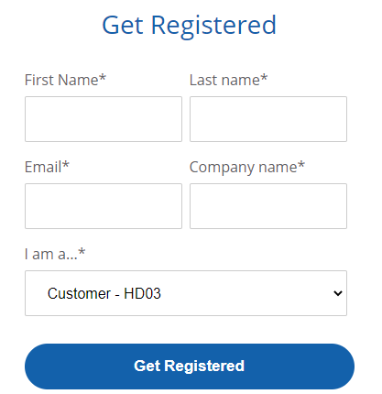
Complete the Form to Create Your Account
Use a facility email address if your facility has a general email address
Select HD03 from the dropdown box

Slide 33
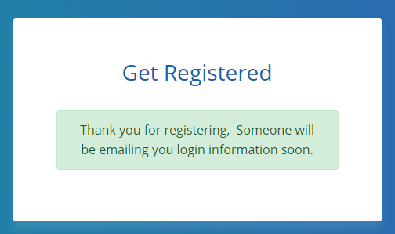
Email Confirmation

Slide 34

Partner Portal Home Page
Click on HD03 Customer

Slide 35
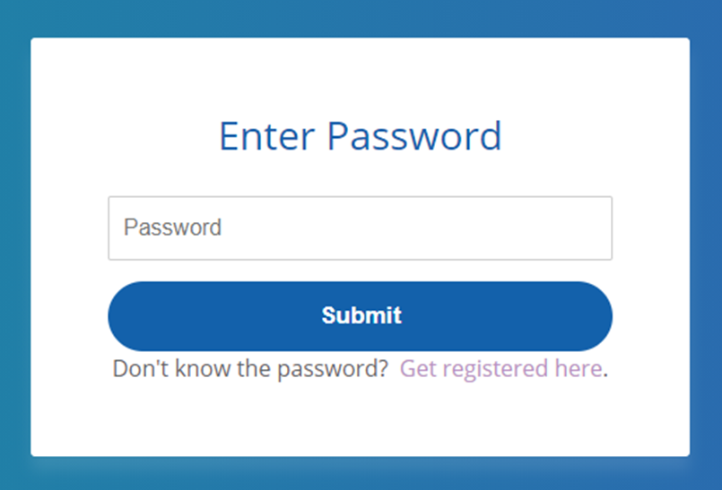
Partner Portal Home Page
You can save the password on your computer, so it will auto populate and go to the Partner Portal.

Slide 36
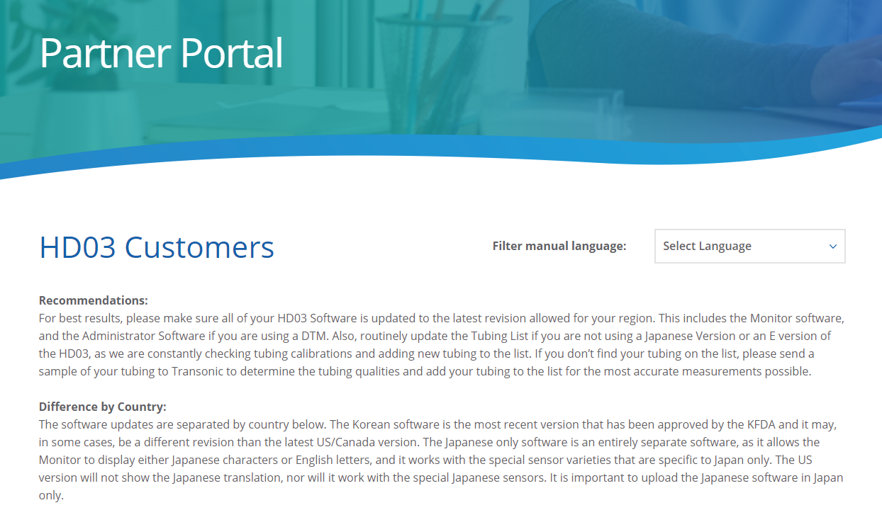
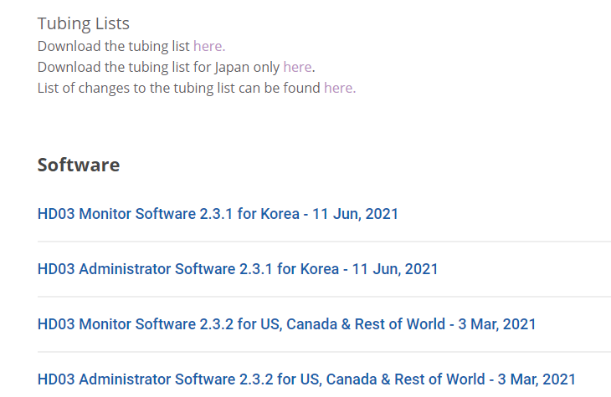
Partner Portal
Scroll down on the page to find the Tubing List, Software Updates & Manuals

Slide 37
Additional Questions?
Please refer to the HD03 Operator’s Manual, Quick Reference Guides, or contact:
Transonic Tech Support 800-353-3569 (US/Canada)
www.Transonic.com

Slide 38
Now Ready to Take Measurements
HD03 Hemodialysis Monitor PowerPoint Training Procedures
Please review the PowerPoints for the specific Transonic Measurements your facility plans to utilize:
Delivered Flow
Recirculation
Access Flow
Cardiac Output
The PowerPoints are intended to provide training support to complement the Operator’s Manual, Quick Reference Guide, and Competency Training Checklists. The tools can also be utilized as a review of the measurement procedures for educational reviews.

