Slide 1
HD03 Hemodialysis Monitor Training
Access Flow Measurement

Slide 2
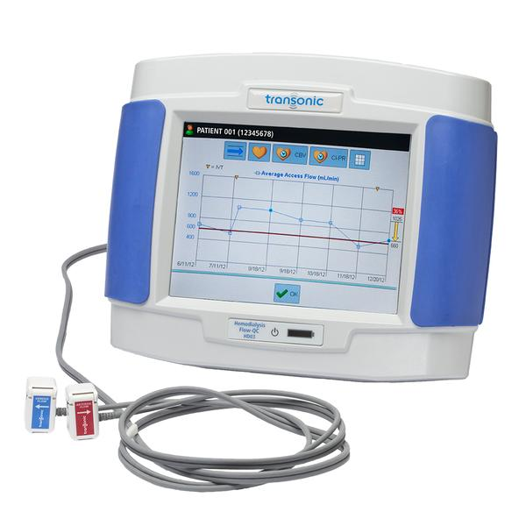
Overview
Prerequisite:
HD03 Hemodialysis Monitor: Delivered Flow, Recirculation, and Access Flow PowerPoint Training Introduction
Training Outline:
Detailed Access Flow Measurement Procedure Steps
Clinical Interpretation for AV Fistula and Grafts

Slide 3
Infection Control: General Concepts
Proper PPE and infection control practices must be utilized to prevent infection or bloodborne pathogen exposure in accordance with your facility specific practices.
If manual line reversal is utilized for the Access Flow measurements, then full PPE should be donned for the procedure.
The Sensor housing and cable should be disinfected after it is in contact with the patient's bloodlines and vascular access.
The Touchscreen should be disinfected between patients as it is a high touch surface.

Slide 4
Set up for Access Flow Measurement:
Utilize the steps detailed in the HD03 Hemodialysis Monitor: Delivered Flow, Recirculation, and Access Flow PowerPoint Training Introduction to select the proper bloodlines (tubing), sensor placement, basic troubleshooting, and disinfection procedures.

Slide 5
Delivered Flow, Recirculation and Access Flow
Sensor Attachment Chairside Steps
Hemodiafiltration or I.V infusions via the extracorporeal circuit can interfere with saline dilution resulting in a Notification/Error Message.
If Hemodiafiltration Mode is active- disable HDF prior to attaching the sensors!
I.V. infusions should be paused prior to Recirculation or Access Flow measurements.

Slide 6
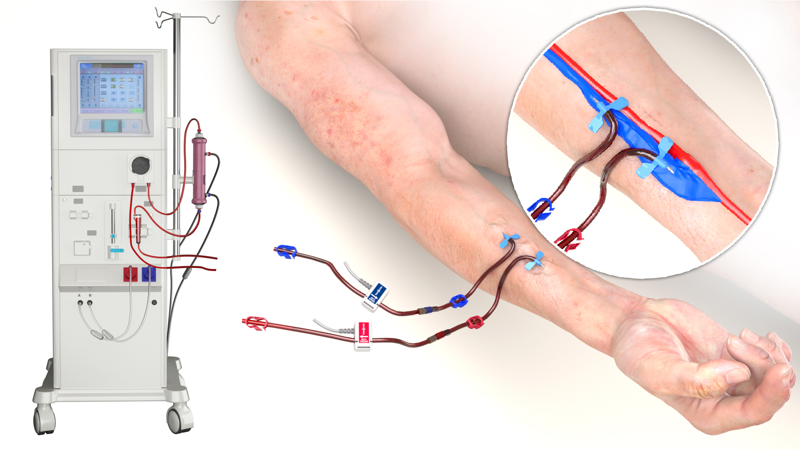
Properly Placed Sensors on Bloodline (Tubing)
Sensor Placement
Properly place Arterial & Venous Sensors on the bloodlines (tubing) for the manual bloodline reversal.
If your facility utilizes a reversing bloodline, please refer to the Quick Reference Guide for the proper Bloodline (tubing) selection and for the Sensor placements.

Slide 7
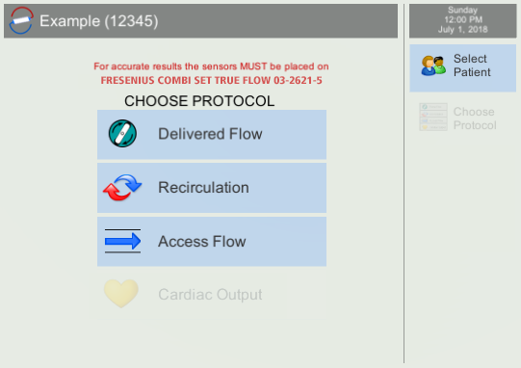
Choose Protocol- Access Flow

Slide 8
Measurement Timing- Access Flow
PATIENT MEASUREMENTS SHOULD BE PERFORMED WITHIN THE FIRST 1.5-2 HOURS FROM START OF DIALYSIS SESSION.
The patient’s heart rate and blood pressure should be checked to ensure that the patient is hemodynamically stable and within their normal HR/BP range. The Access Flow correlates with the Mean Arterial Pressure, Blood Pressure, Heart Rate, and Cardiac Output. Therefore, for trending purposes the Access Flow should be measured when the patient is hemodynamically stable and within their normal HR/BP range.

Slide 9
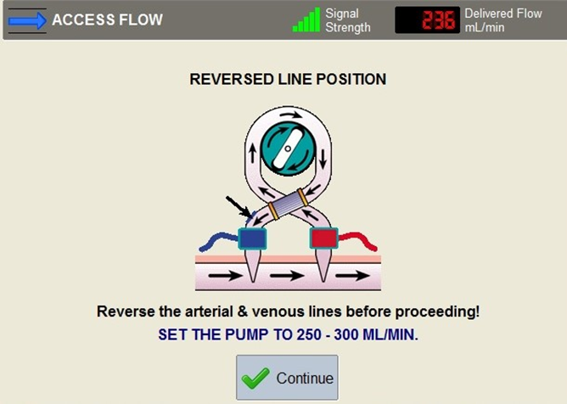
Steps to Reverse Bloodlines for Access Flow
Reversing Bloodline
Steps:
Turn blood pump down to 250-300 mL/min range
Confirm that the flow is within the 250-300 mL/min range on Delivered Flow
Next set of slides will detail the manual line reversal procedure that must be completed prior to selecting the Continue Button

Slide 10
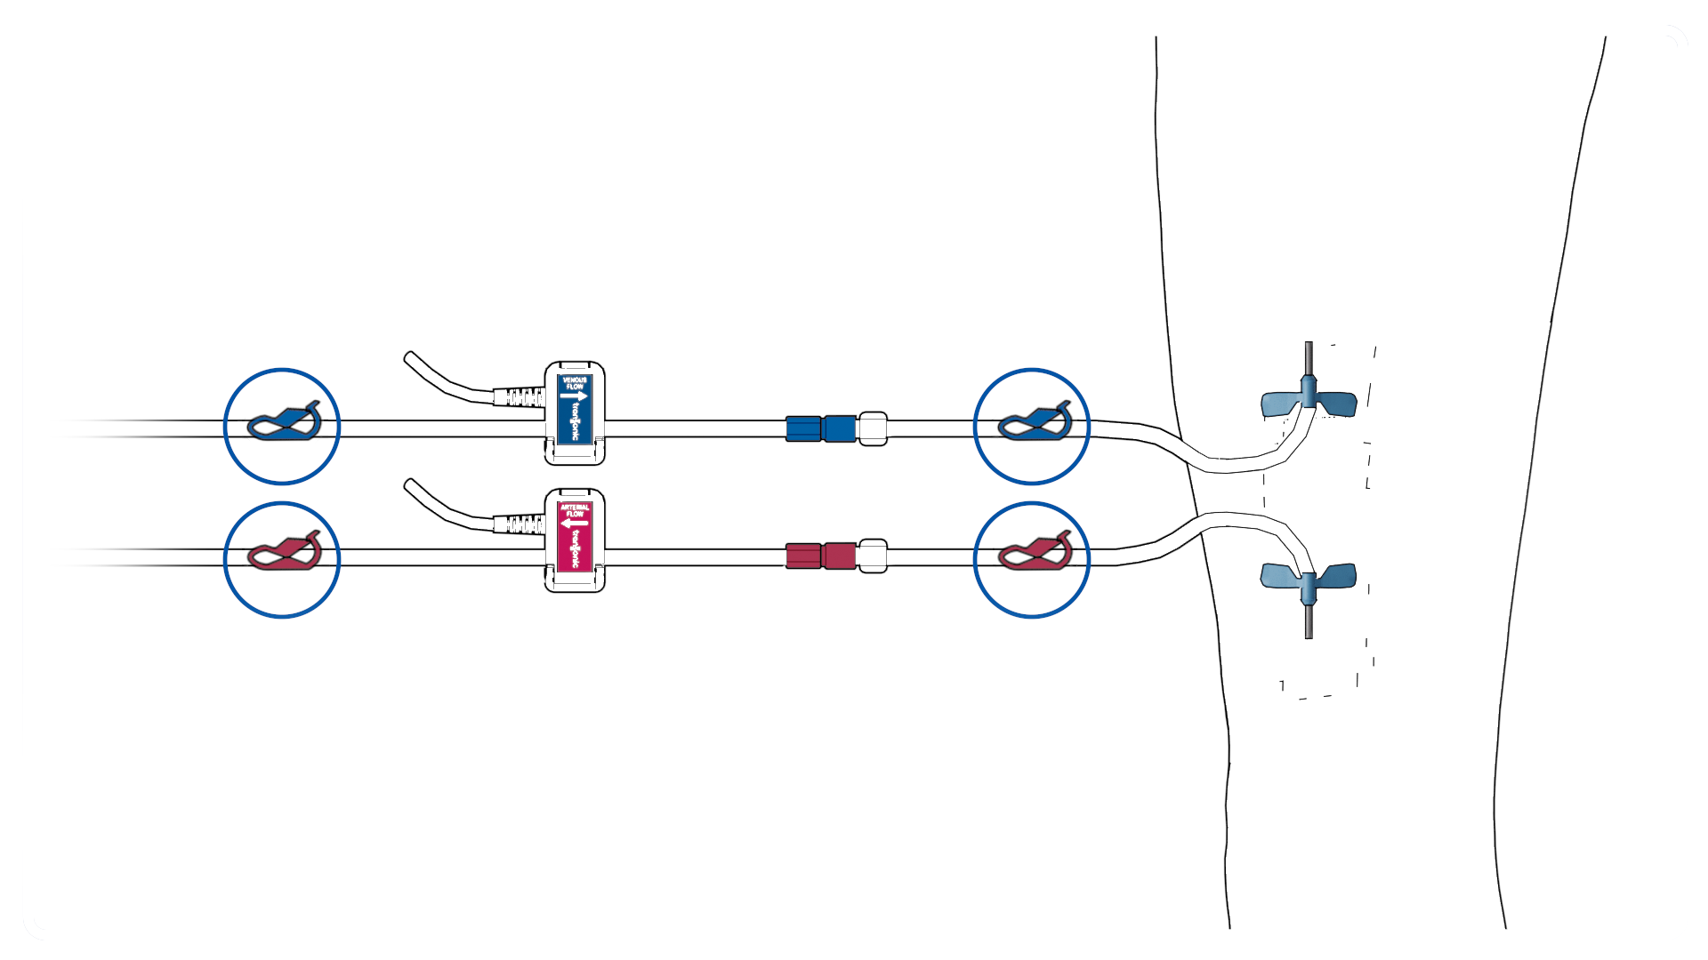
Bloodline Reversing Steps:
Reversing Bloodline
Steps
Stop the pump, clamp bloodlines & needle clamps

Slide 11
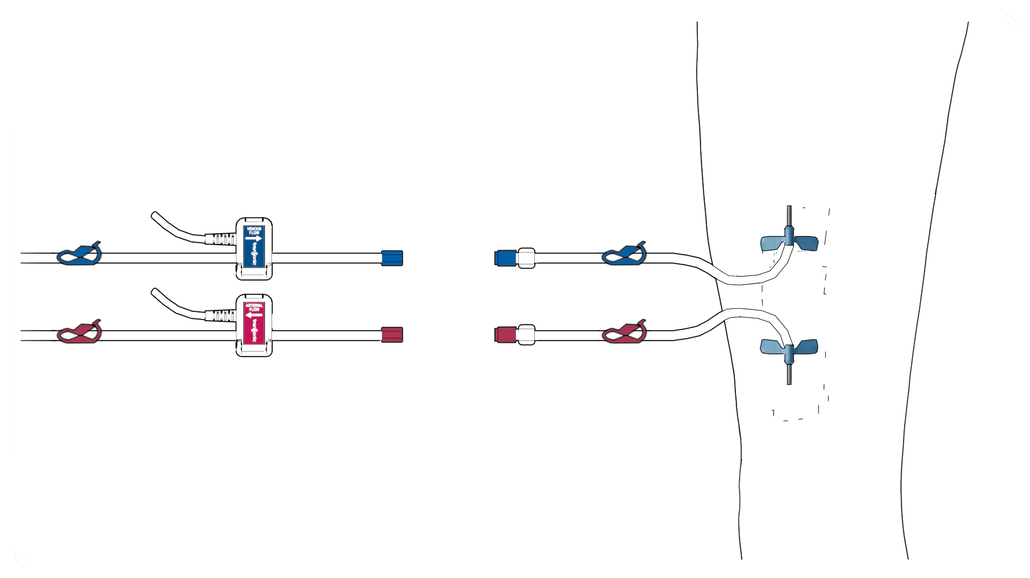
Bloodline Reversing Steps:
Reversing Bloodline
Steps
Aseptically separate the lines

Slide 12
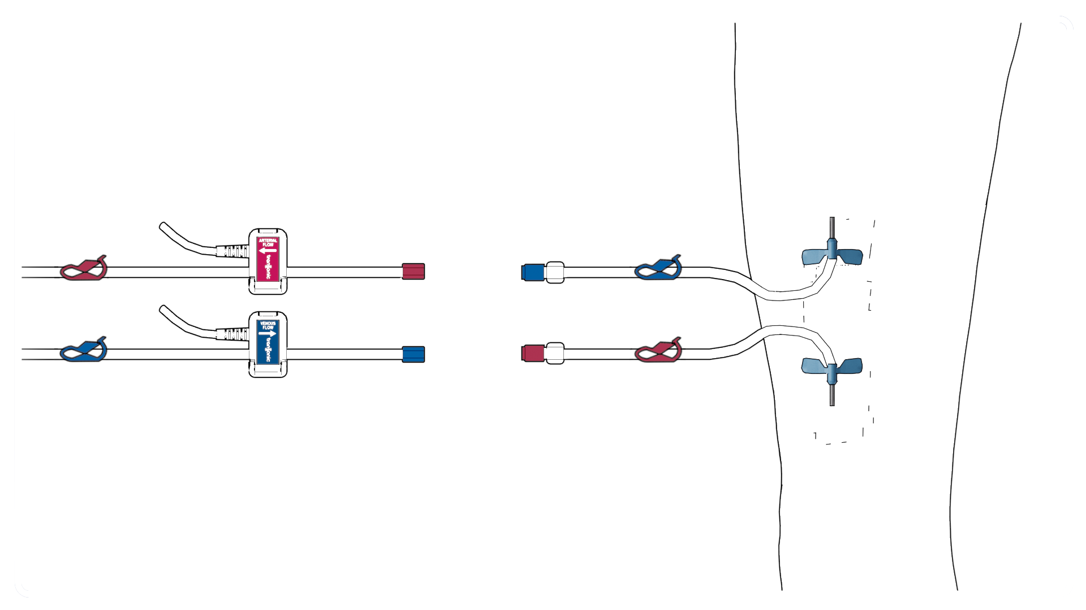
Bloodline Reversing Steps
Reversing Bloodline
Steps
Aseptically reverse the lines
Arterial Bloodline
Venous Needle
Arterial Needle
Venous Bloodline

Slide 13
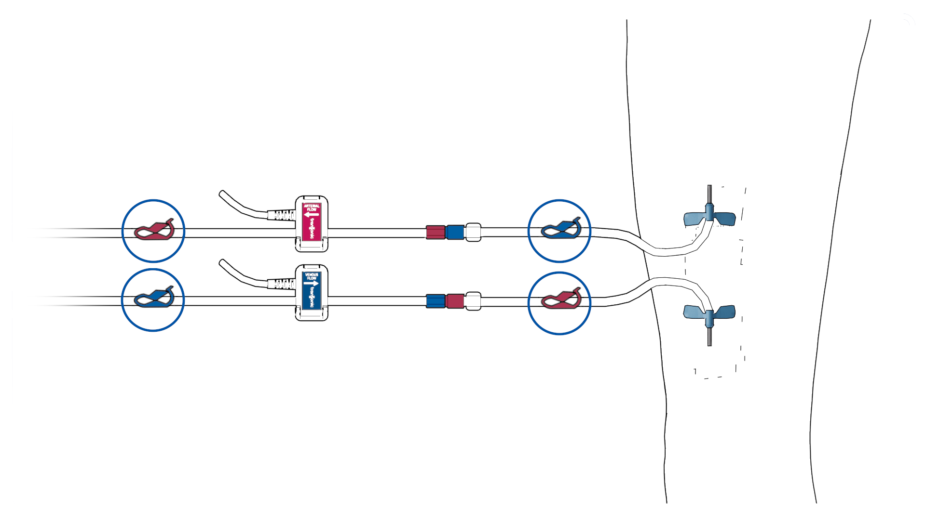
Bloodline Reversing Steps
Reversing Bloodline
Steps
Securely attach the lure lock connections

Slide 14
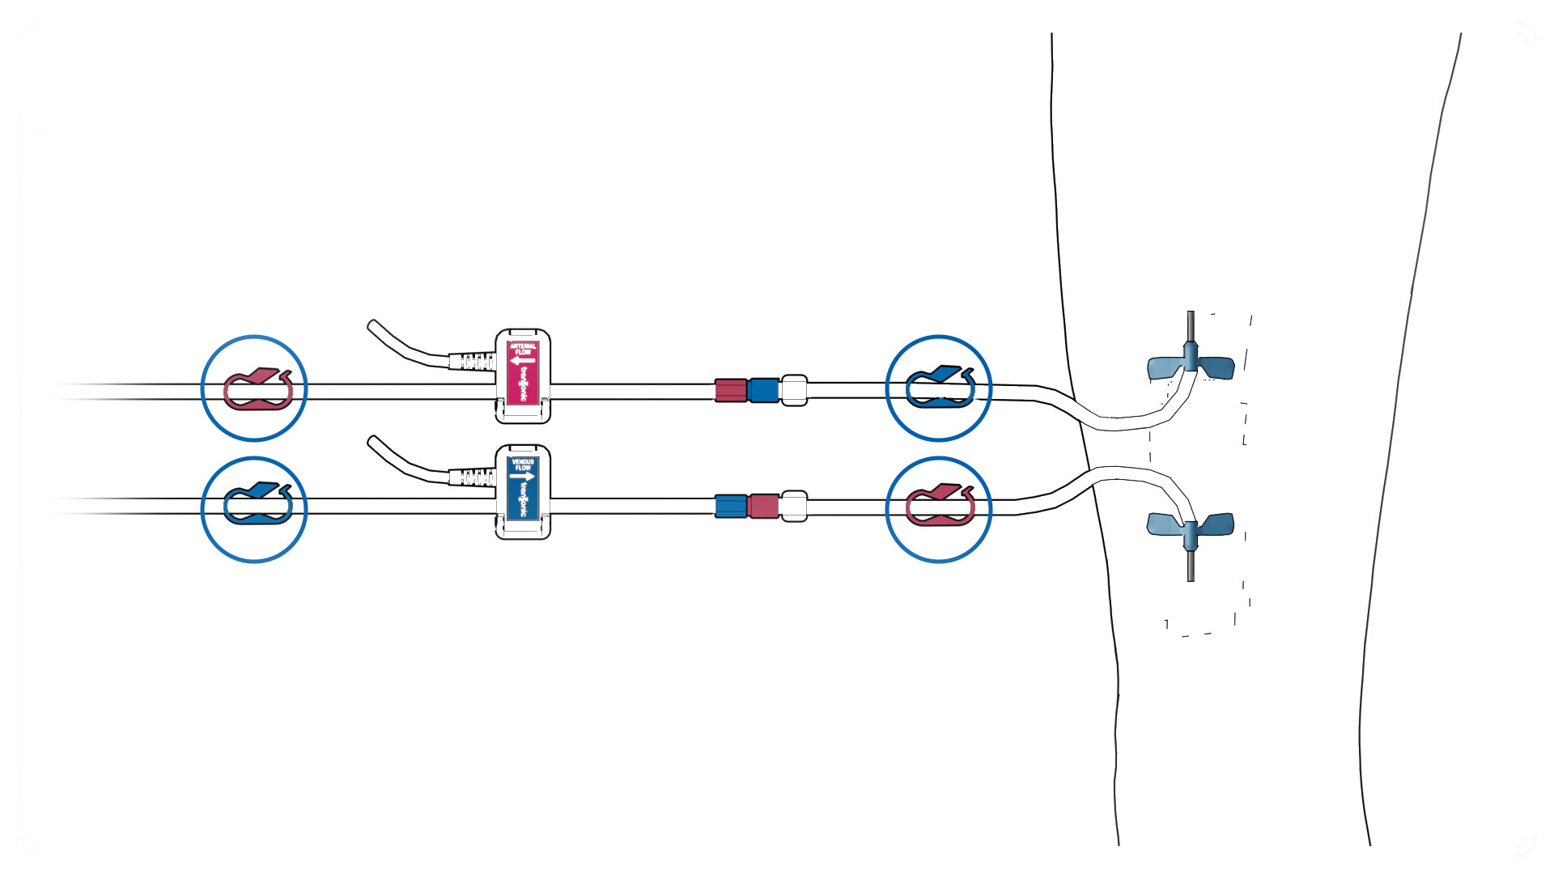
Bloodline Reversing Steps
Reversing Bloodline
Steps
Open all 4 clamps
Restart pump to 250-300 mL/min range

Slide 15
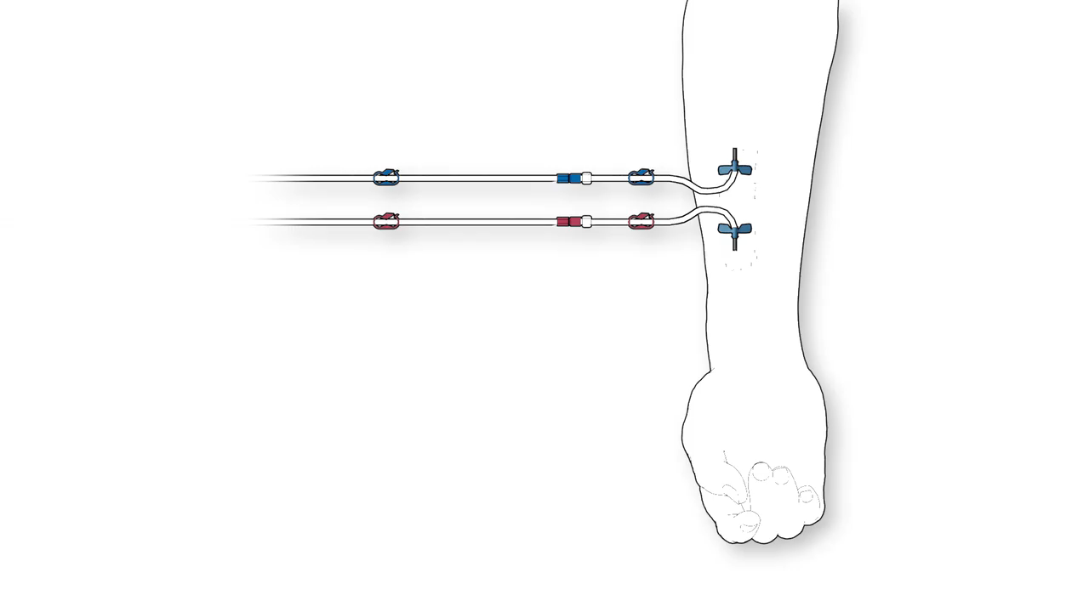
Bloodline Reversing Steps-Access Flow Animation
Click to play animation

Slide 16
Select Continue to Proceed
Reversing Bloodline
Steps:
Once the manual reversal steps have been successfully completed: then select the Continue Button to advance to the saline dilution steps.

Slide 17
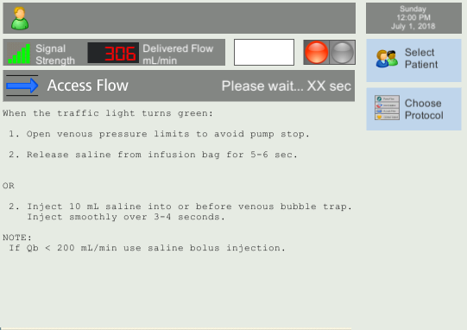
Inject or Release Saline:
Two Methods
Saline release from the saline bag
OR
Saline bolus into the venous drip chamber via port (pigtail)
NOTE: The Traffic Light remains red for 60 seconds as the HD03 obtains the baseline flow. Do not follow the on-screen instructions until the Traffic Light turns green.

Slide 18
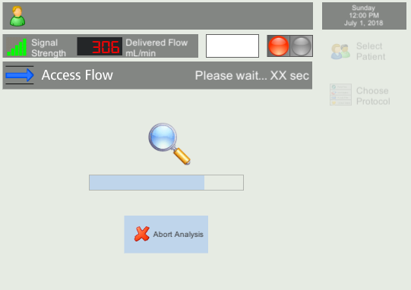
Keep Venous Pressure Limits Open/Spread During Measurement
If alarm occurs or blood pump is stopped for any reason the measurement must be repeated. Open/Spread the pressure alarm limits as the saline is being infused and until the saline has cleared the venous bloodline; typically this occurs once the screen progresses to the Analyzing screen.
Technical Note: Expanding Pressure Limits to Avoid Pump Alarms during
HD03 Recirculation and Vascular Access Measurements available with the HD03 Tools

Slide 19
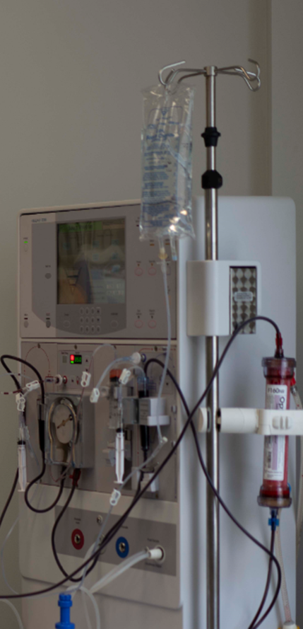
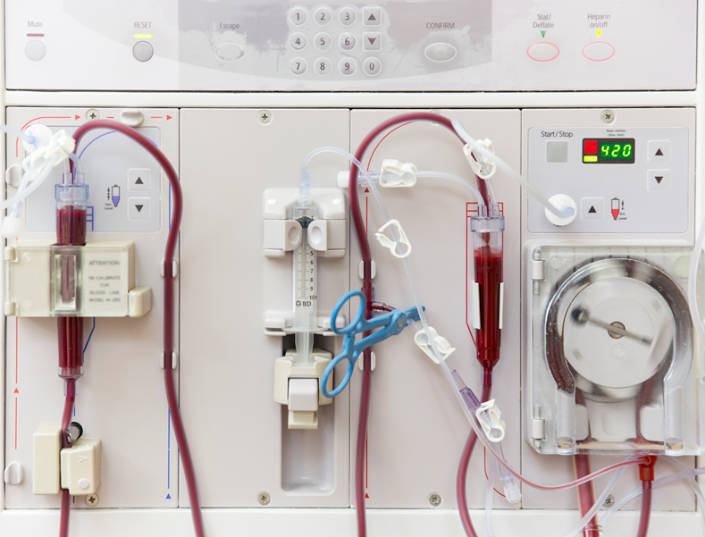
Saline Release- Access Flow
Most saline lines have at least one inline clamp.
Some saline lines have two with one by the bag and one closer to the saline infusion site on the Arterial Line (pre pump).

Slide 20
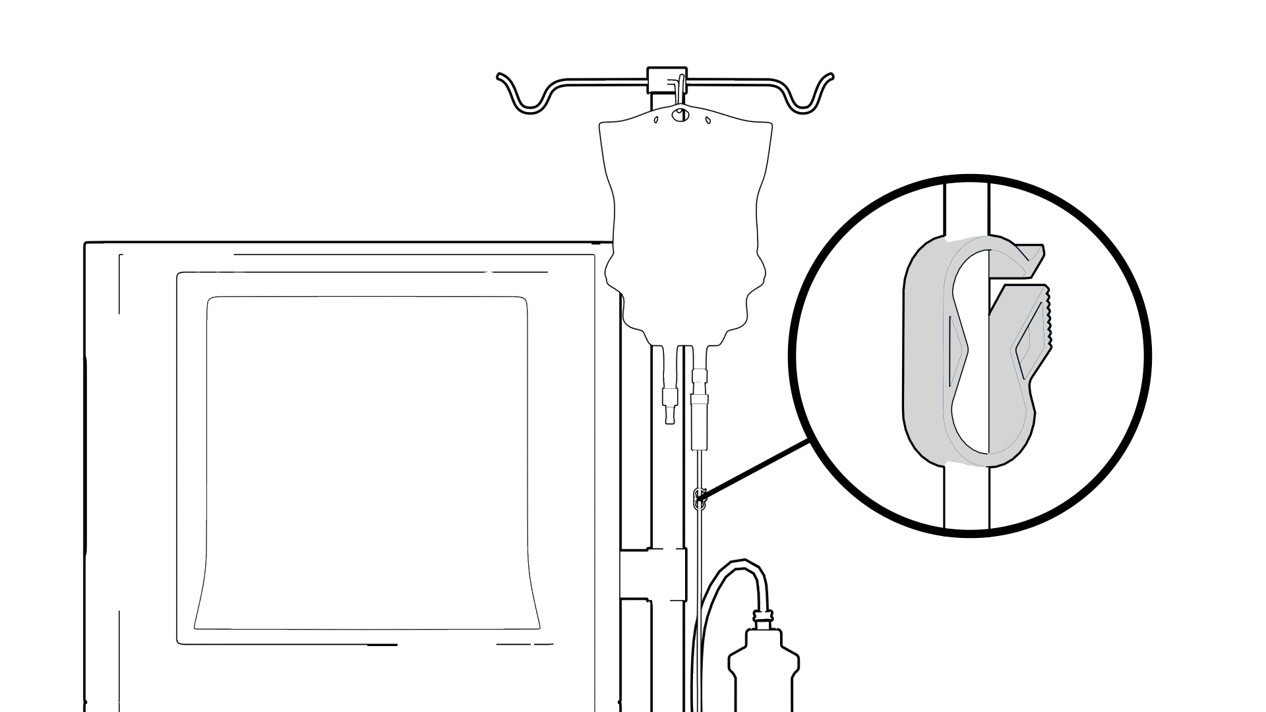
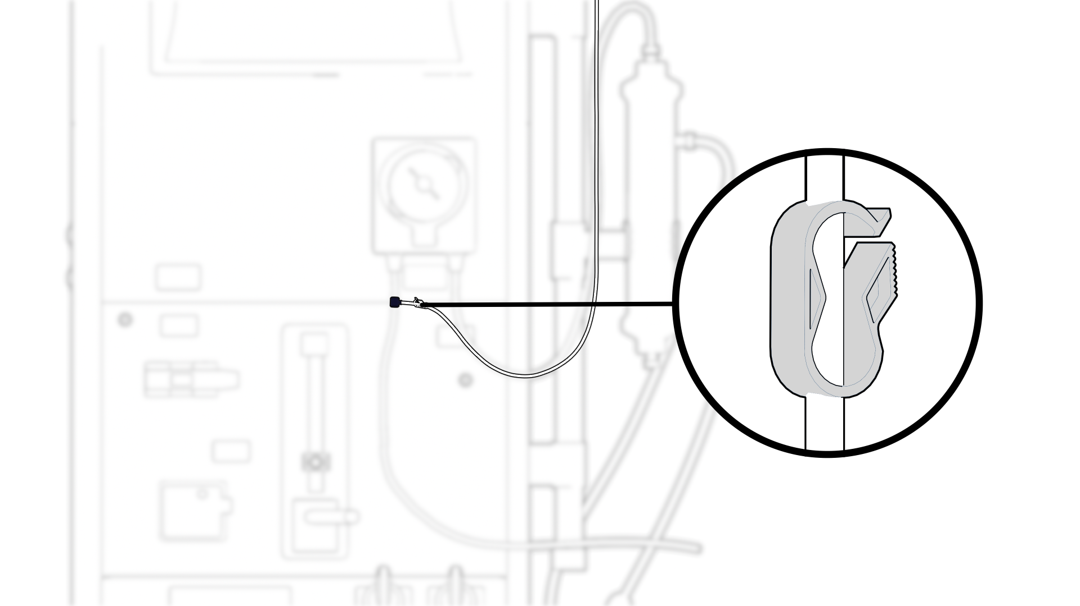
Saline Release-Access Flow
Saline Release Steps
WHEN THE TRAFFIC LIGHT TURNS GREEN
Open venous pressure limits to avoid pump stop
Open saline clamps to release saline from infusion bag for 5-6 sec
Do not clamp off the Arterial bloodline, just open the saline clamps to allow the saline to slowly infuse approximately 10 mL’s
(5-6 sec) of saline from the
bag

Slide 21
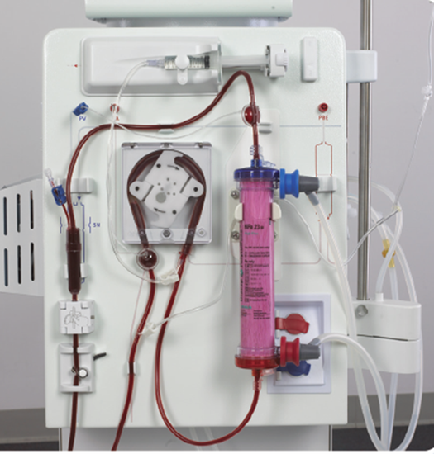
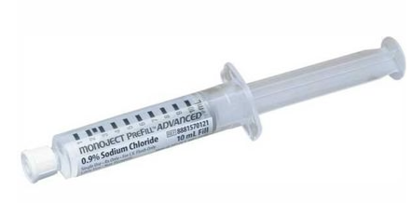
Saline Dilution-Access Flow
Saline Bolus Steps
Hemodiafiltration machines utilize purified dialysate instead of a saline bag
A Saline bolus must be used with these machines

Slide 22
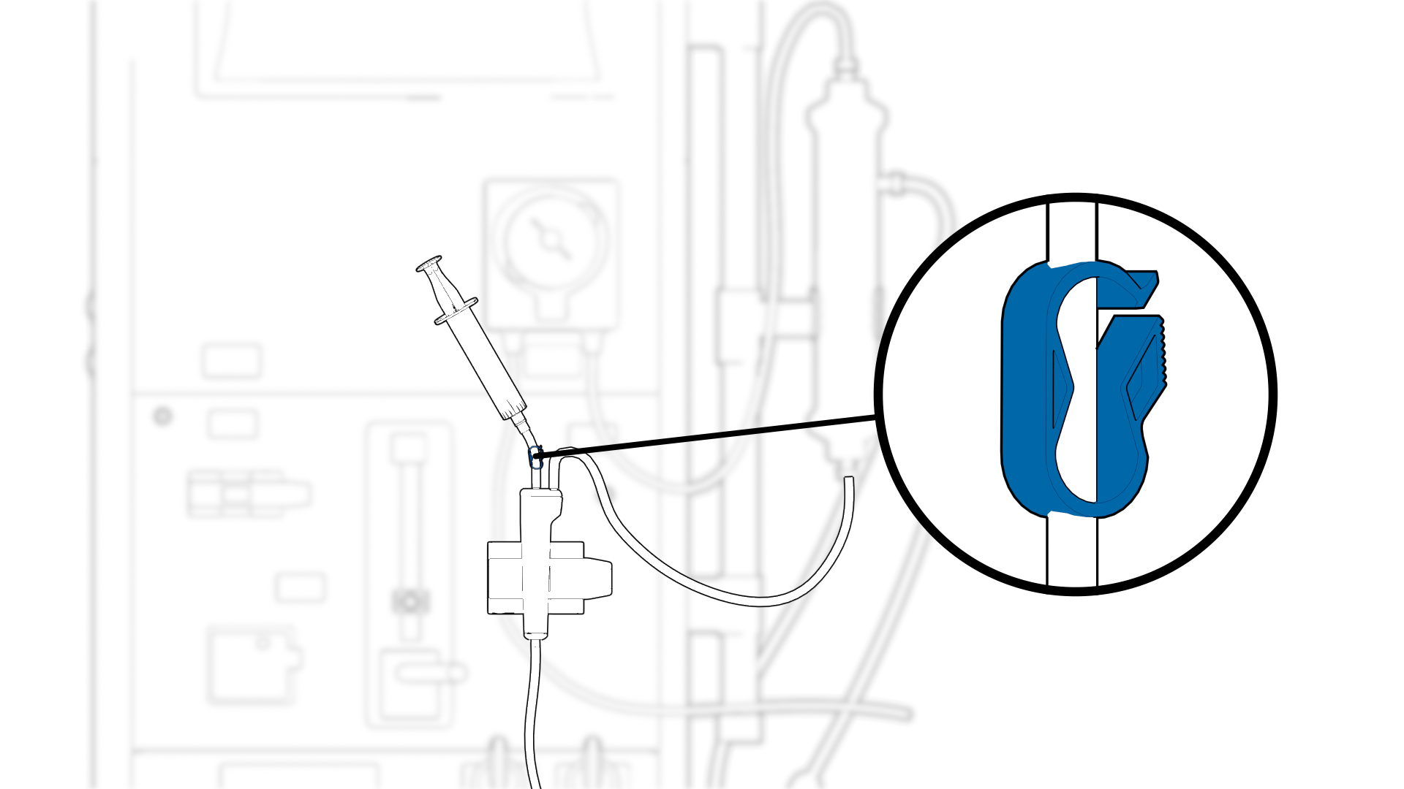
Saline Dilution – Access Flow
Saline Bolus Steps
Inject 10 mL saline into or before venous bubble trap via the injection site (pigtail) Inject smoothly over 3-4 seconds

Slide 23
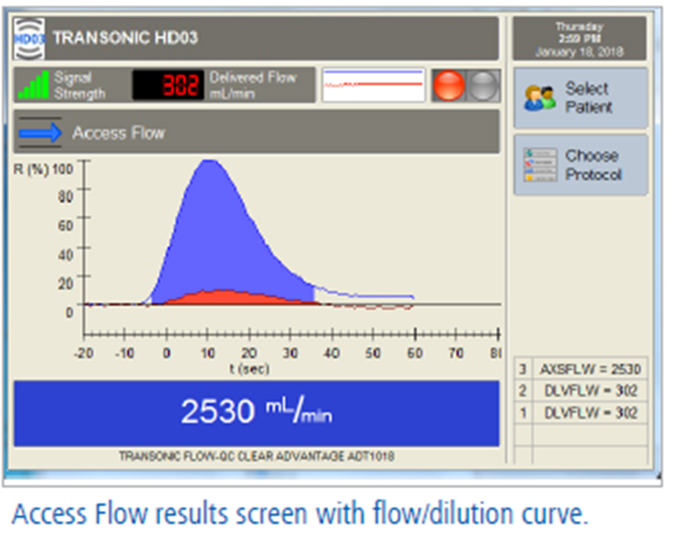
Access Flow Measurement Result
Result Steps
DTM Users: Result will be saved and can be viewed under the Patient Record icon.
PMM Users: you MUST Manually record result into the patient’s treatment/ medical record. The result will clear when Next Patient icon is activated
Access Flow Measurements can be repeated as needed once the Traffic Light turns green again

Slide 24
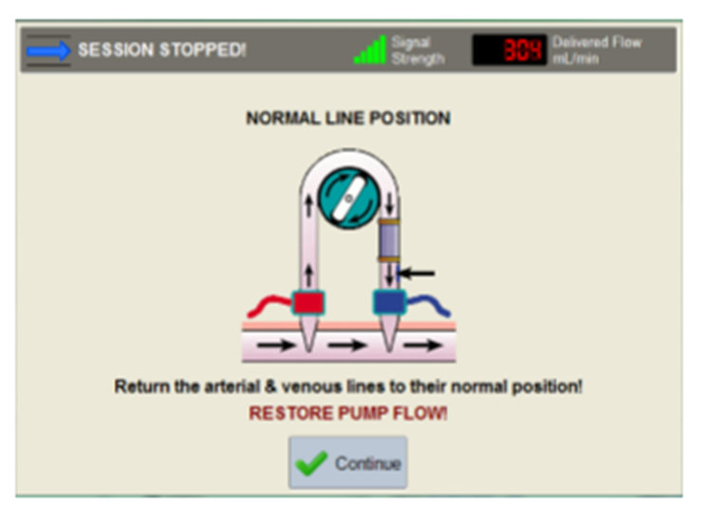
Return Bloodlines to Normal Position
Return Bloodlines to Normal: Overview
Stop the pump, clamp bloodlines & needle clamps
Aseptically reverse the lines back to the normal position
Open all 4 clamps
Restart the pump to the patient’s prescribed BFR

Slide 25
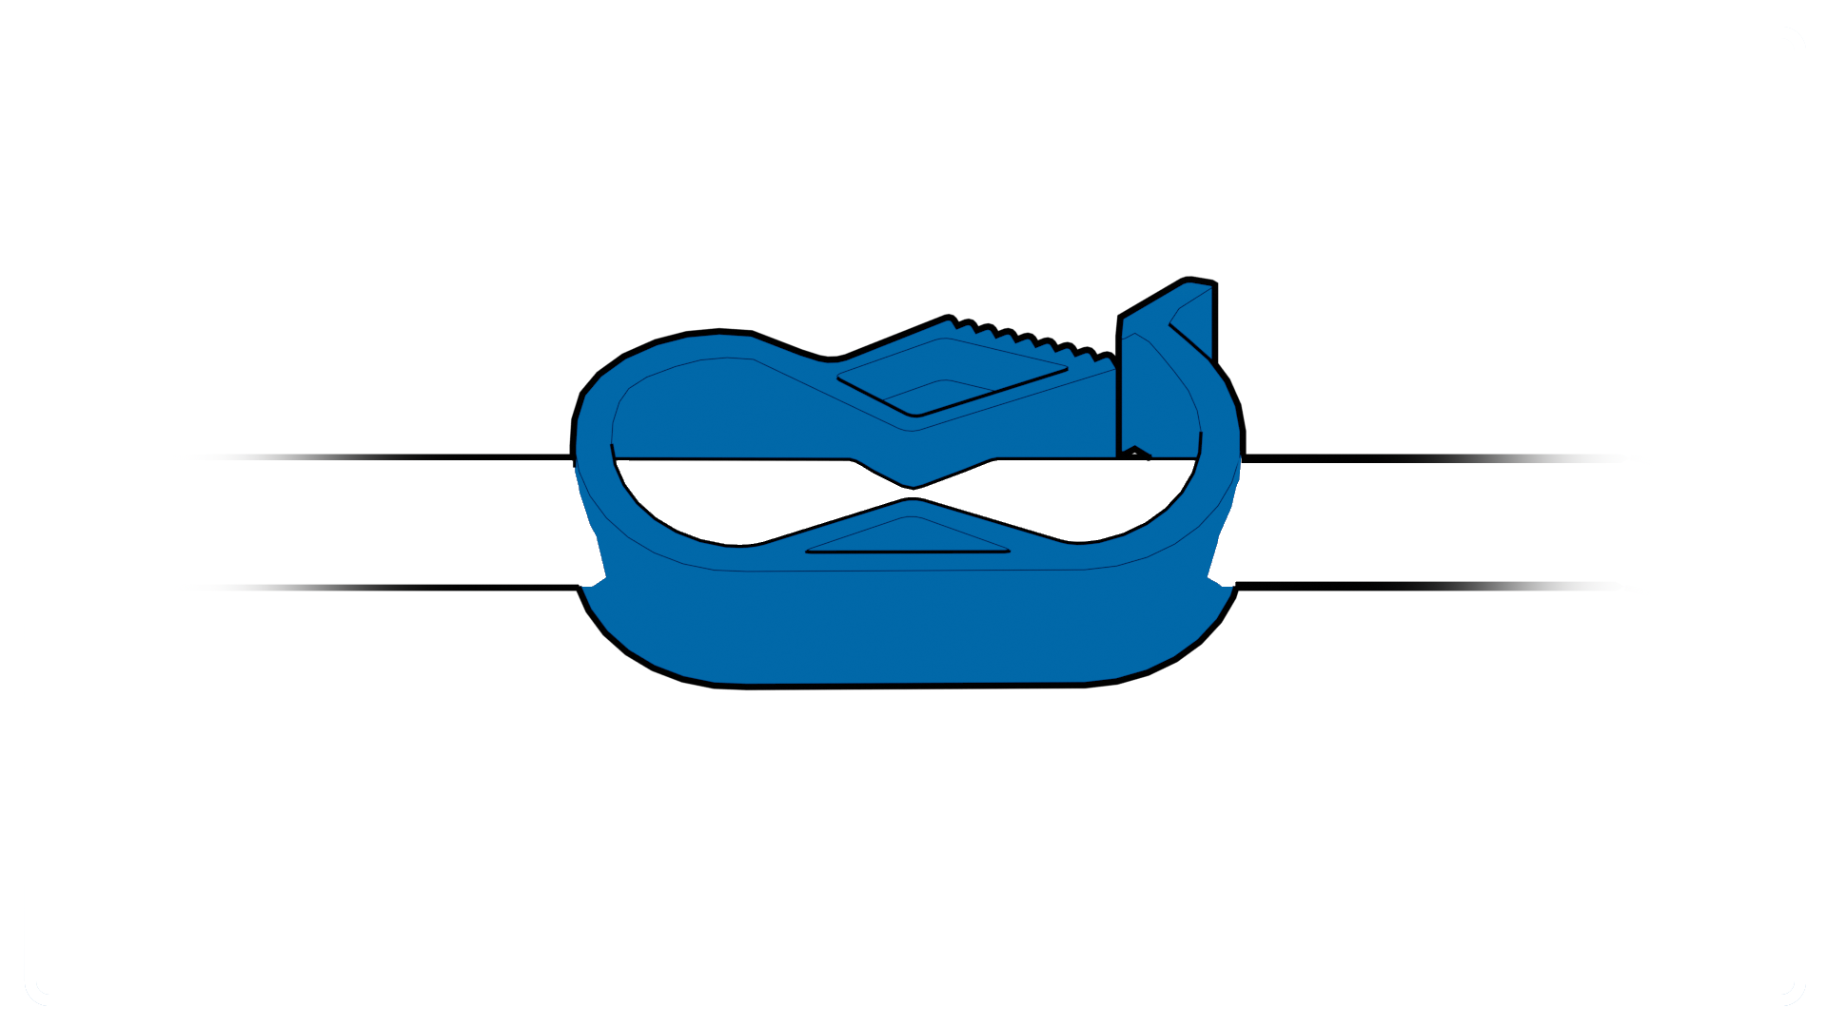
Return Bloodlines to Normal
Return Bloodline to Normal: Detailed Steps
Stop the pump, clamp bloodlines & needle clamps

Slide 26
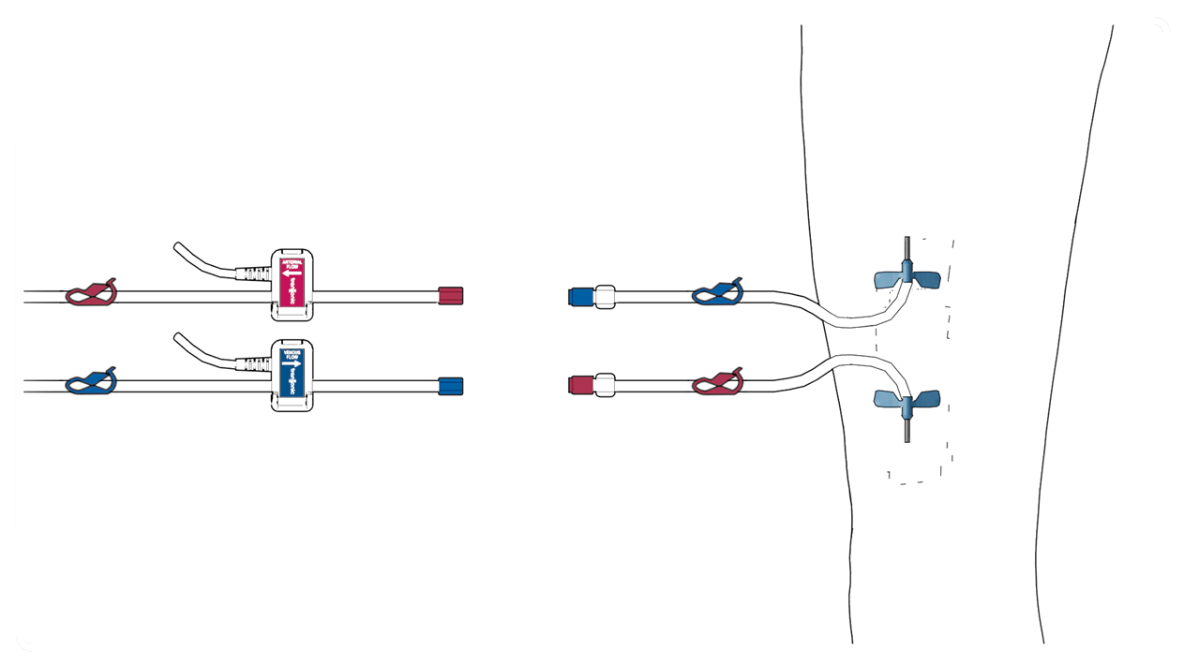
Return Bloodlines to Normal
Return Bloodline to Normal Steps
Aseptically separate the lines

Slide 27

Bloodline Return to Normal
Return Bloodline to Normal Steps
Attach the bloodlines back to the normal position
Securely attach the lure lock connections

Slide 28
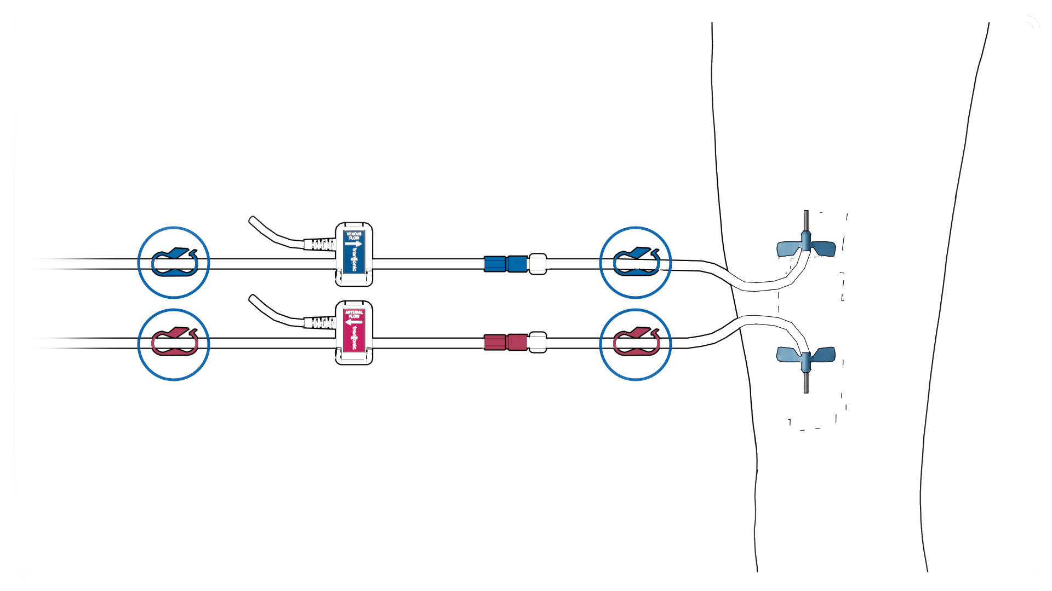
Return Bloodlines to Normal
Return Bloodline to Normal Steps
Open all 4 clamps
Restart the pump to the patient’s prescribed BFR

Slide 29
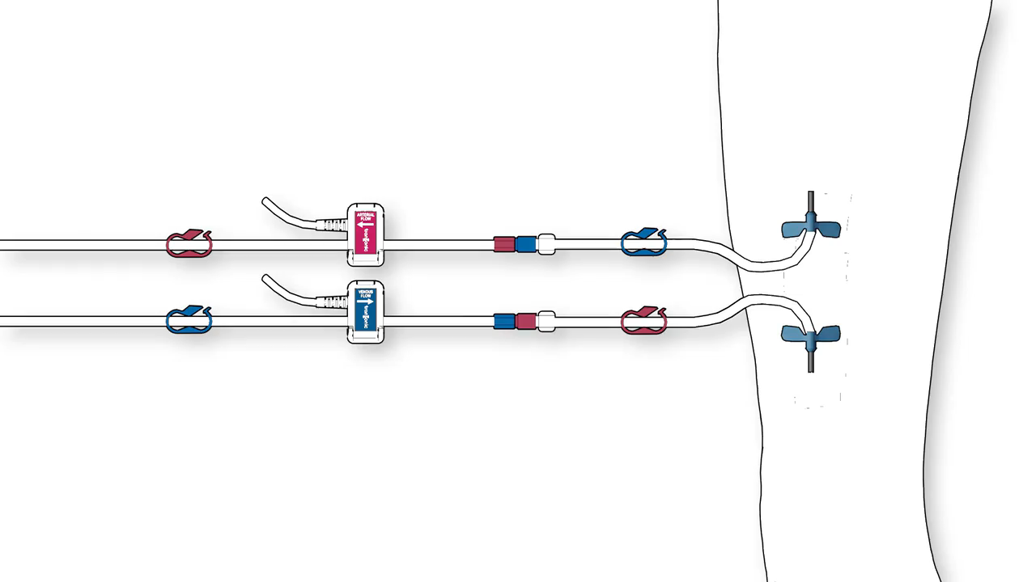
Animation: Returning Bloodlines to Normal
Click to play animation

Slide 30
Tips for Adequate Saline Mixing in Fistulas for Access Flow Measurements
If delivered blood flow is 200-300 mL/min, any needle orientation (toward or away from incoming access flow) produces adequate mixing for up to 2 liters of flow.
In fistulas with a large aneurysm, or in upper arm fistulas with >2 L/min of flow, the arterial needle should be positioned so that it faces incoming access flow. Evaluate the needle placement for the next dialysis session and repeat Access Flow measurements.
When measuring Access Flow you may see the message “Check Line Reversal and Needle Placement”. This occurs when the needle is in a collateral or branch of the vein
When measuring access flow with a needle in a collateral or branch of the vein, you may see the message “Check Line Reversal and Needle Placement.” Confirm the message by repeating the measurement. If the message repeats, evaluate the needle placement for the next dialysis session and repeat Access Flow measurements.

Slide 31
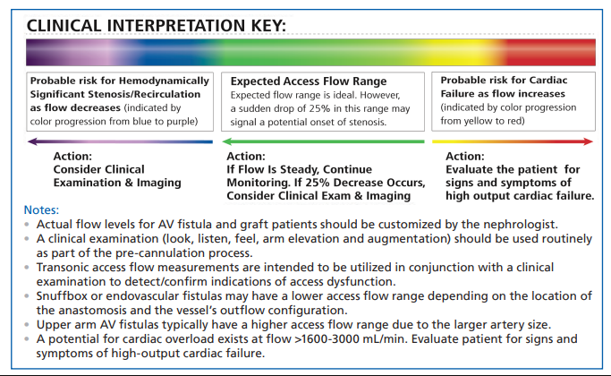
Access Flow Interpretation-AVF
AVF
Actual flow levels for adult fistula patients should be customized for each patient by the nephrologist
The low flow threshold is dependent on the location of the access and the patient size/cardiac status
A potential for cardiac overload exists at flow >1600- 2000 mL/min.
Evaluate the patient of S/S of high output cardiac failure

Slide 32
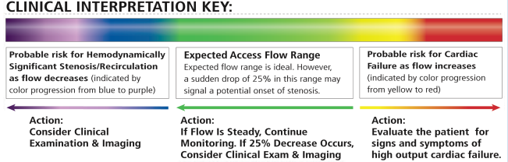
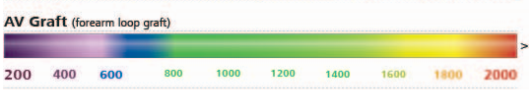
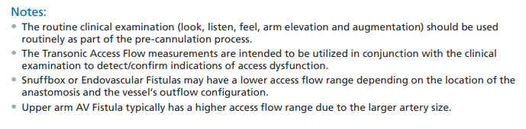
Access Flow Interpretation-AVG
AVG
Actual flow levels for adult graft patients should be customized for each patient by the nephrologist
Literature suggests AF< 800 -600 mL/min as the low flow threshold depending on the location of the access and the patient size/cardiac status
A potential for cardiac overload exists at flow >1600- 2000 mL/min.
Evaluate the patient of S/S of high output cardiac failure

Slide 33

Documentation for DTM Users Only: Patient Records
Patient Information
Patient Record
Displayed at the top of the Patient Record screen is the Patient name, ID number, and patient trend graphs. The icons identify the various parameters. Clicking on each icon reveals a graph with corresponding variables.
Patient record Icon

Slide 34
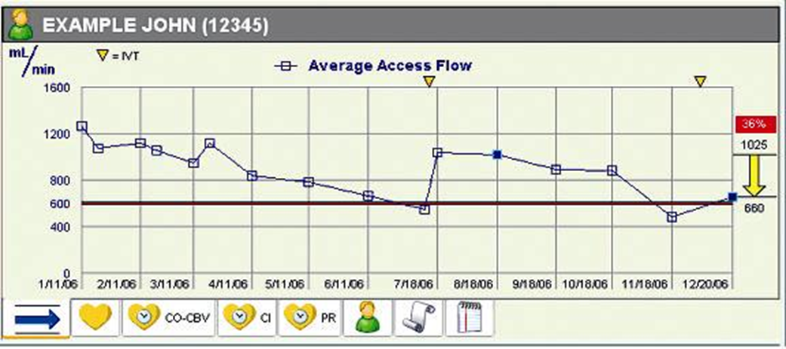
Documentation for DTM Users Only: Trending
Access Flow measurements for a patient are graphed. Yellow triangles at the top of the graph indicate interventions.

Slide 35
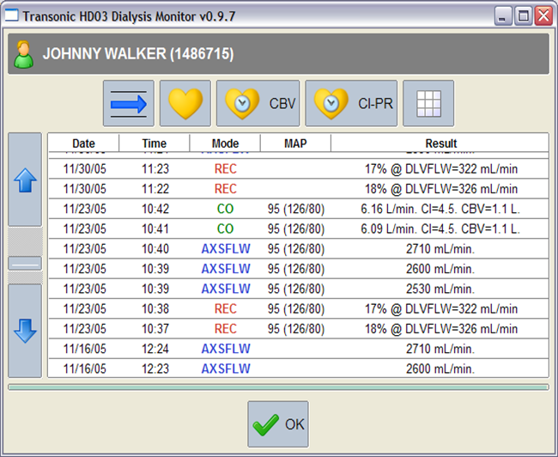

Documentation for DTM Users Only: Table Review
Patient Measurements Table
Tabulated measurements for a patient include includes Date, Time, Mode, Mean Arterial Pressure (MAP), and Result. Under the mode column, DLVFLW = Delivered Flow, AXSFLW = Access Flow, REC = Recirculation, CO = Cardiac Output and IVT = Intervention
Patient Measurements Table Icon

Slide 36
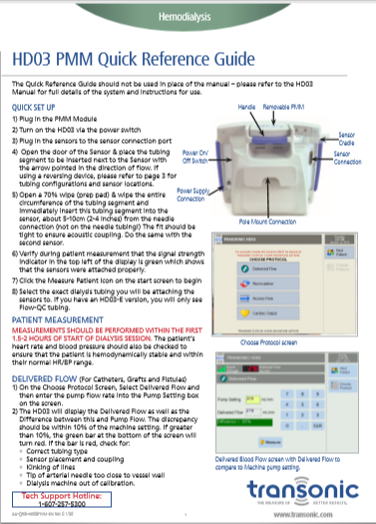
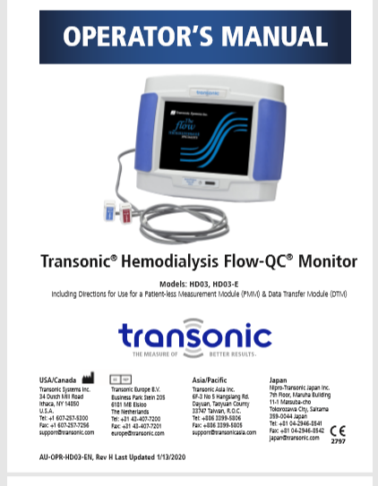
Transonic HD03 Tools www.Transonic.com

Slide 37
Transonic HD03 Tools www.Transonic.com
Customer Updates & Training Web Portal
Software Updates
Training Materials
Training Videos
Training Checklists
Operator’s Manuals

Slide 38



Customer Login to Access the Partner Portal
You can click on any of the three buttons to access the Partner Portal
Top right of the home page
Click on Contact Us then select Partner Portal
Click on Software Updates on the bottom of the home page

Slide 39
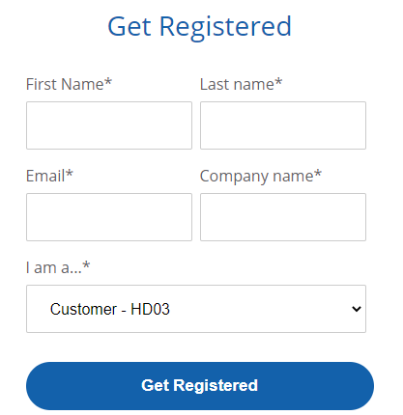
Complete the Form to Create Your Account
Use a facility email address if your facility has a general email address.
Notifications about your HD03 will be sent to the email used to register.
Select HD03 from the dropdown box

Slide 40

Partner Portal Home Page
You can save the password on your computer and then the password will auto populate and it will go right to the Partner Portal

Slide 41

Partner Portal Home Page
Click on HD03 Customer

Slide 42
Partner Portal Home Page
You can save the password on your computer and then the password will auto populate and it will go right to the Partner Portal

Slide 43
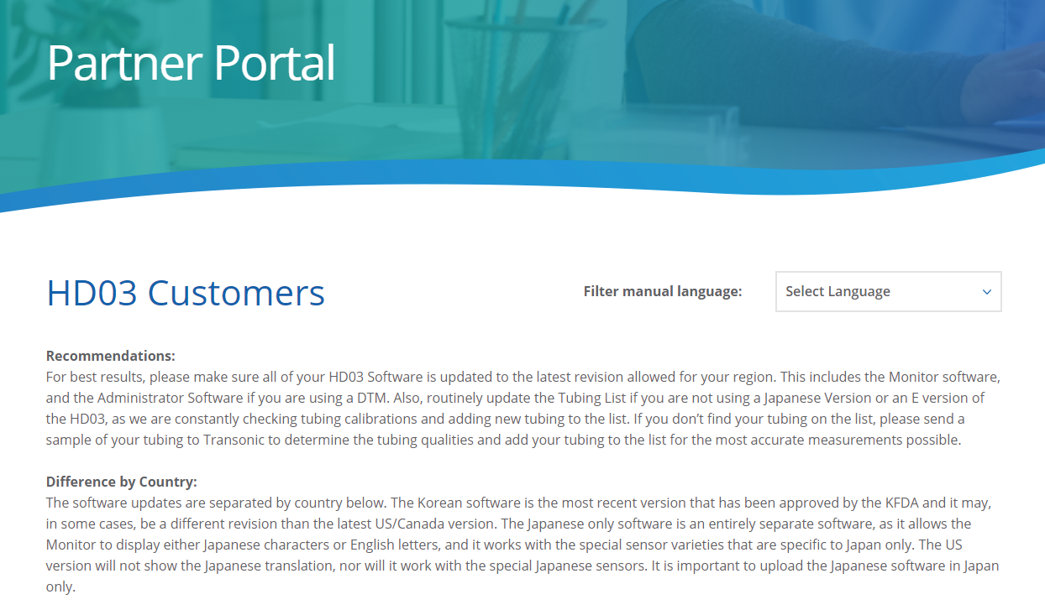
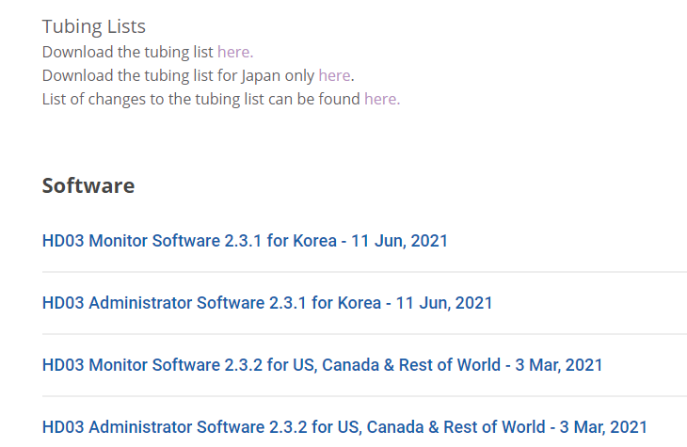
Partner Portal
Scroll down on the page to find the Tubing List, Software Updates & Manuals

Slide 44
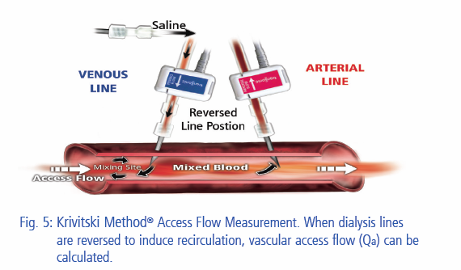
Access Flow Measurement Method

Slide 45
Access Flow Measurement Method – How it Works
When saline is introduced into the venous line, it dilutes the blood’s protein concentration and reduces ultrasound velocity. This blood protein concentration change is detected first by the sensor clipped onto the venous blood line. The Monitor’s software then generates a venous dilution curve. The diluted blood from the venous line then enters the access and mixes with the incoming access flow. Upon reaching the arterial needle, a portion of mixed blood is removed from the access by the dialyzer. The diluted blood is then detected by the arterial sensor. The Monitor’s software generates an arterial dilution curve. Access flow is calculated from the ratio of the area under the venous curve to the area under
the arterial curve. The use of two sensors (arterial and venous) effectively eliminates multiple factors such as viscosity that influences ultrasound velocity.

Slide 46
Additional Questions?
Please refer to the HD03 Operator’s Manual, Quick Reference Guides, or contact:
Transonic Tech Support 800-353-3569 (US/Canada)
www.Transonic.com

